Slide 1
Ed Reform 2.0
Personalized Learning in Orwellian Times

Slide 2
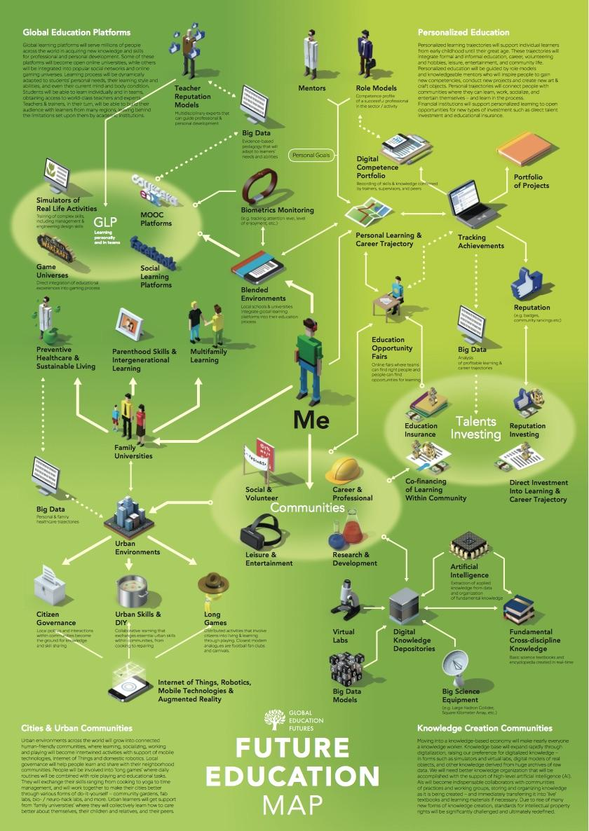
Global Education Futures foresight documents include many elements of Ed Reform 2.0.
Click HERE for the report.
Click HERE for the slideshare.
Click HERE for the essay “A Learning Day 2037.”

Slide 3
Use a critical lense to examine the role of technology in today’s classroom.
Are our schools being digitally colonized?
Who created these technologies? Gates, Zuckerberg, Thiel, Hastings….
Ultimately, whose interests are served by school redesign for a digital age?
Do “free” ed-tech tools perpetuate power imbalances?
Do they offer children and teachers freedom or subjugation?

Slide 4
HUMANITY
?
FREE WILL
Future Ready Schools

Slide 5
What is the end game?
Eliminate local control.
Automate the teaching profession-AI advances in service industries.
Create a new system built on data-mining / surveillance.
Eliminate or minimize school buildings in favor of drop-in centers.
Shift to a majority cyber model with a bit of community-based learning.
Virtual wallet ESAs and badging systems will enable the ecosystem model.
Shift to a human-capital, skills-training mindset.

Slide 6
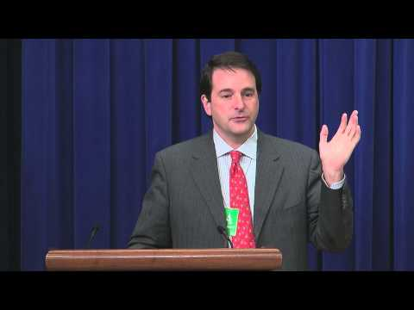
Knewtown
Datapalooza
2012
“What if your math syllabus could tell you what to eat for breakfast to score higher on your quiz tomorrow?...
Knewton collects millions of data points about student users in order to provide them with more effective timing and content to enhance learning.”
Youtube Link

Slide 7
School Redesign
Whole Child
Credit Flexibility
Eliminate “Seat Time”
Innovative Assessments
Language of Ed Reform 2.0
Future Ready Schools
Outdated “Factory” or “Industrial” Model
Disruption
Out of School Time Learning
Innovating Toward Equity
Data-Rich Environments
Vibrant Learning Grids

Slide 8
ESSA changed the game.
We’re Dealing With Ed Reform 1.0
Vouchers
Charters
Teach for America
School Closures / Turnaround Plans
High Stakes Testing-End of Year
Value Added Teacher Accountability
Austerity Budgeting
Broad Academy Superintendents
Non-Elected School Boards
They’re Implementing Ed Reform 2.0
Learning Eco-Systems
Hybrid-Blended Learning / Teacher On the Side
Online Gaming Platforms
Augmented & Virtual Reality Simulations
“Whole Child” Data Collection-SEL & Behavior
Credit Earned Outside School (ELOs)
Standards-Based Grading
Digital Badges & Online Portfolios
Workforce Pathways
Education Savings Accounts / Blockchain / Bitcoin

Slide 9
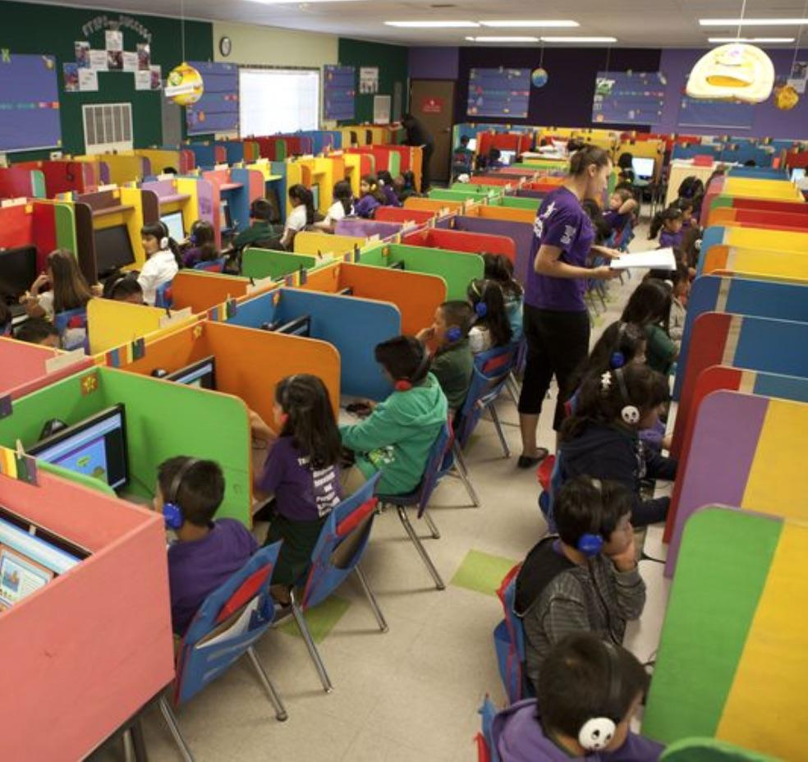
It’s all in how you frame the conversation, and the reformers have a head start.
Innovative
Student-Centered
Personalized
Adaptive
Blended-Hybrid Learning
Formative (Stealth) Assessments
Gamified Education Software
1:1 Devices Initiatives
Untested
Isolated
Data-Mined
Controlled
Limited Access to a Human Teacher
Online Surveillance
Behavior Modification
Data Gathering Platforms

Slide 10
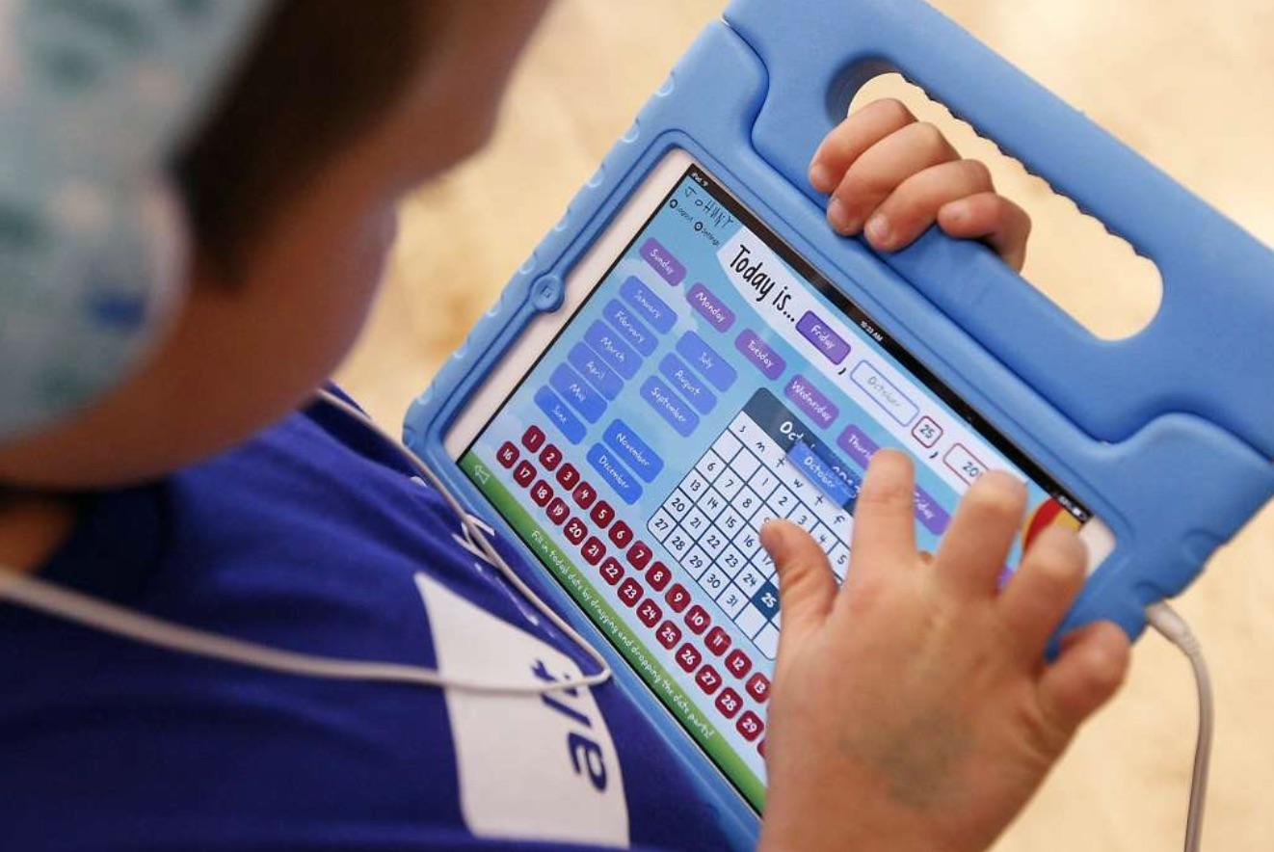
What does Ed Reform 2.0 look like?
More instruction happens through devices.
More data is collected.
School budgets prioritize tech over human staff.
Standards-based skills badging becomes important.
More screen time-concerns for vision, health, and emotional well-being.
Less face-to-face social interaction with teachers and peers.
Differentiation will happen via computer and eventually AI “personal tutors.”

Slide 11
Access to information is determined by algorithms that data-mine their past performance.
Student access to new course material is limited by their level of mastery.
Standards-based grading and online portfolios replace report cards and diplomas.
Age-based class groupings go away. Everyone does their own thing on their own schedule.
Informal community-based learning experiences become equivalent to in-school education.
Project based learning is used to monitor soft skills deemed important to the workforce.
Students become consumers of content of playlists, not independent creators.

Slide 12
Data-Driven Education
Personally Identifiable Information
Information that directly identifies an individual or that can be used to identify, contact, or locate specific individuals in conjunction with other data sets
Metadata
Data About Data
How was it created?
How is it used?
Who is the author?
When was it created?
Where is it stored?
File type?
File size?
How is it tagged-keywords?
AND/OR

Slide 13
How much data?
All of it please.
Academic Knowledge
Mastery of Skills
Behavior &
Social Emotional
Grit & Growth Mindset
Collection Methods:
Computer Log Ins
IDs-RFID Chips & Facial Recognition
Online Education Modules & Games
Classroom Management Software
“Fitbit” Type Devices
Device Cameras, Microphones, Screens
Surveys-Naviance, College Board, etc.
Community Partners
“Whole Child”
Data Collection
Family Situation
Trauma/ACES
Bio-Metric
Health
Facial Recognition

Slide 14
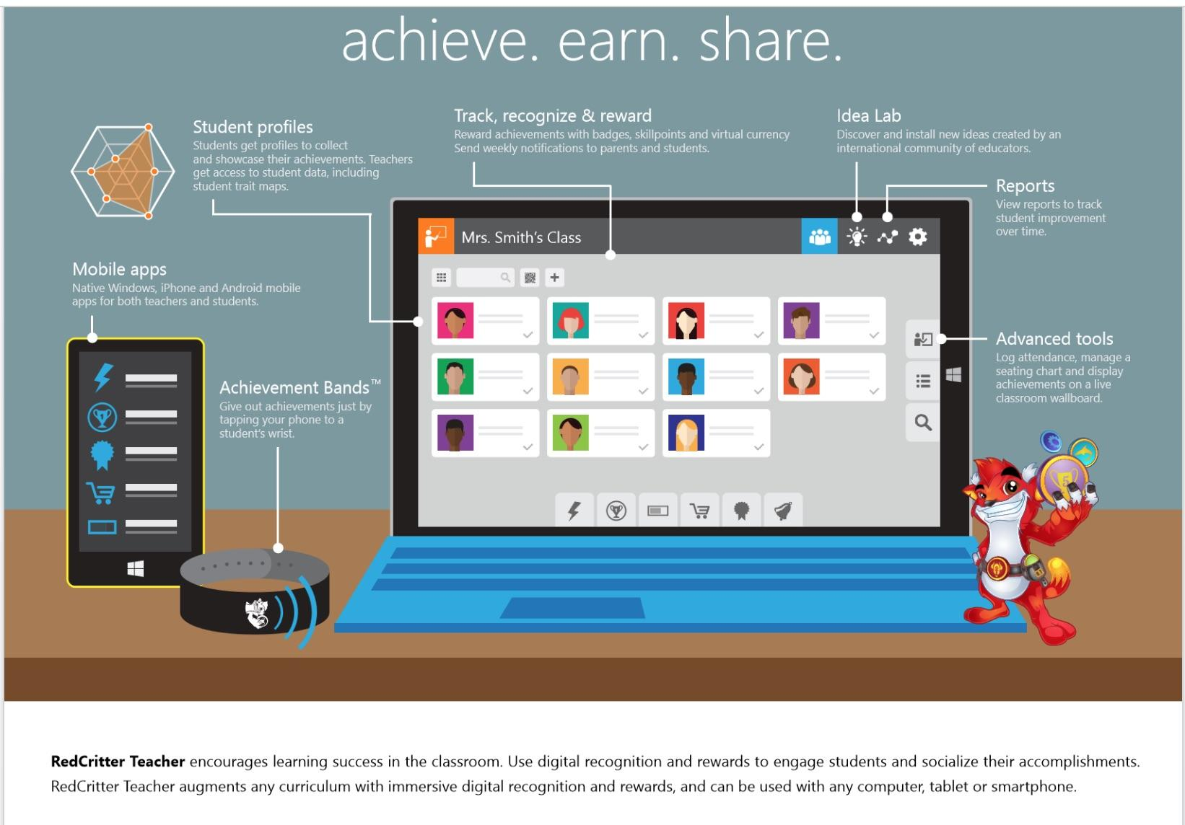
RedCritter: Skinnerian Model
Operant Conditioning
Behavior Shaping
Achievement Wallboard
Parent Notifications
Phone/Achievement Bands
Token Economy
Badges
Skillpoints
Virtual Currency

Slide 15
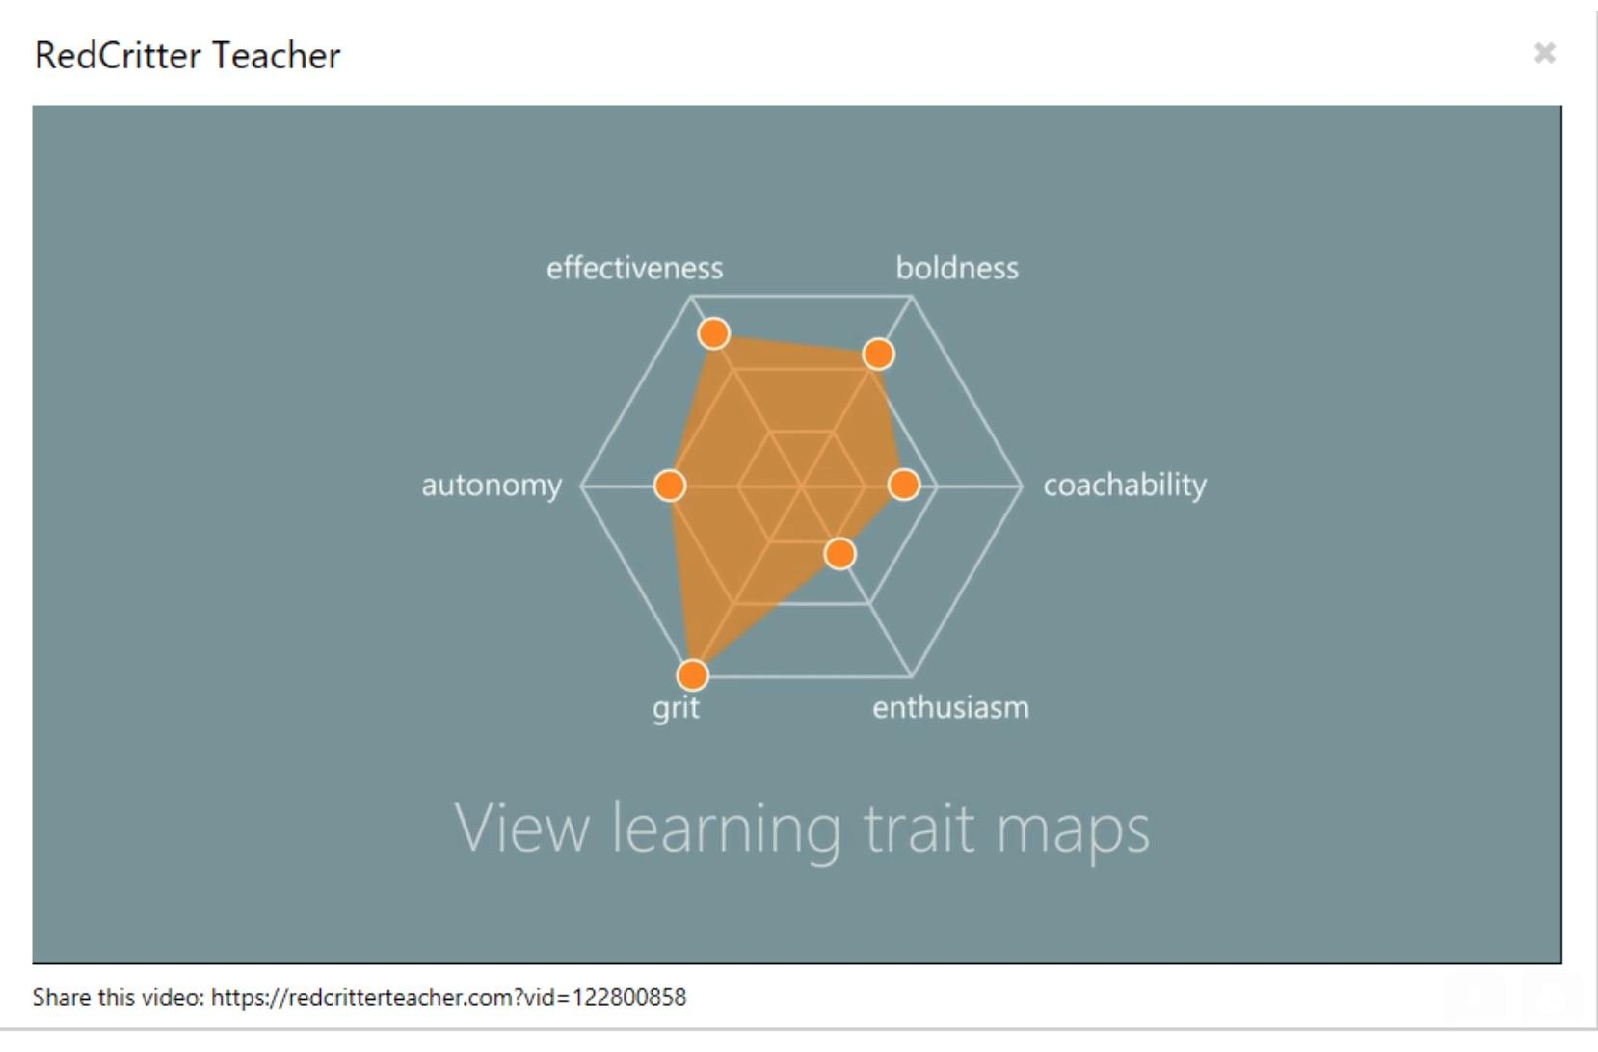
ESSA has thrown open the door to the collection of SEL data.

Slide 16
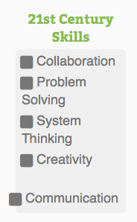
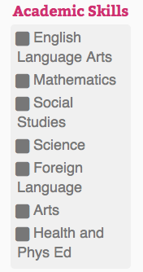
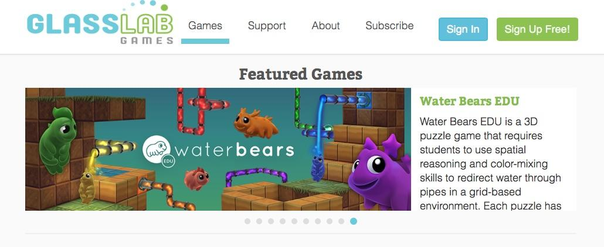
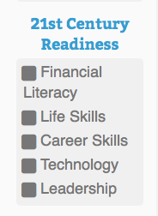
Gamification & SEL Data Collection
“Besides being an efficient and engaging educational tool, virtual environments also collects a lot of behavior data which can be used with Educational Data Mining (EDM) techniques to assess students' learning competencies.”

Slide 17

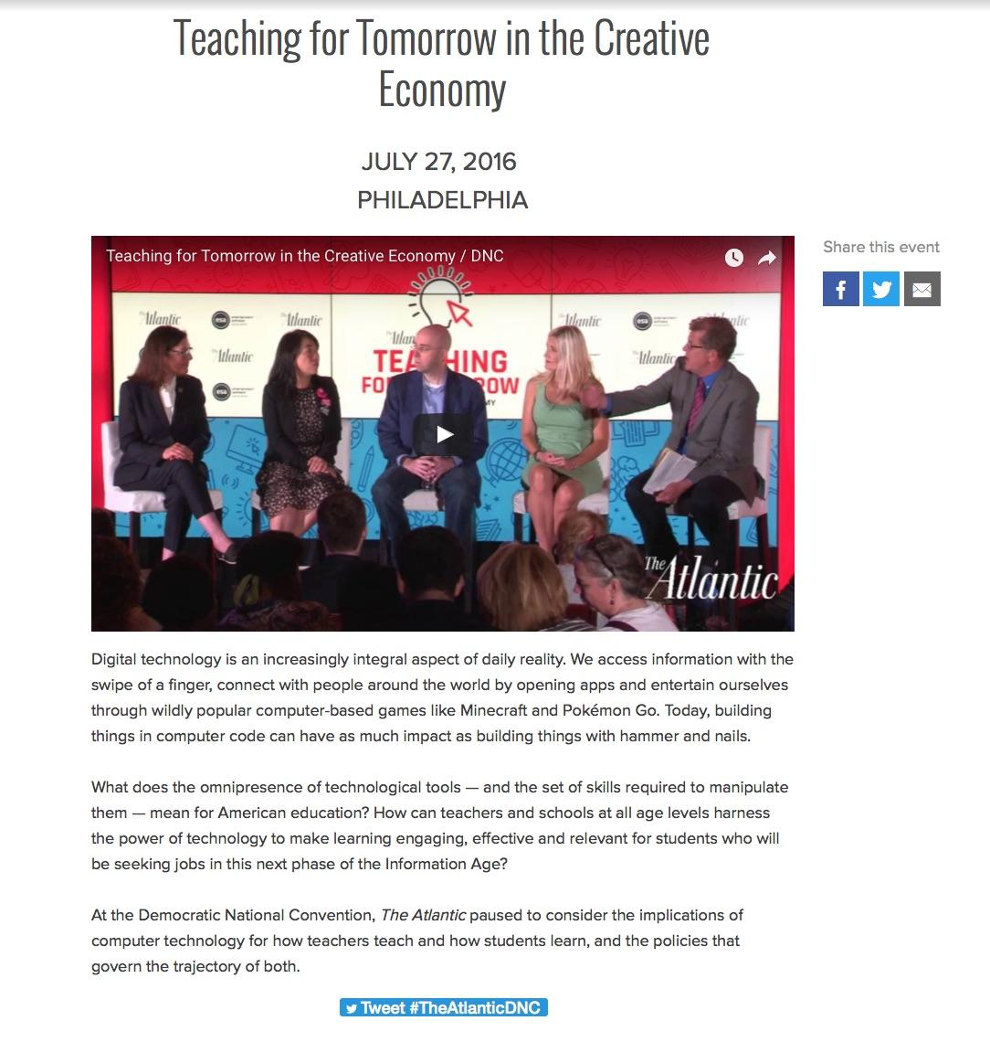
Sesame Credit

Slide 18
Devices are continuously watching and listening.
“It was terribly dangerous to let your thoughts wander when you were in any public place or within range of a telescreen. The smallest thing could give you away. A nervous tic, an unconscious look of anxiety, a habit of muttering to yourself – anything that carried with it the suggestion of abnormality, of having something to hide...There was even a word for it in Newspeak: facecrime, it was called. The Party’s surveillance tactics and technology are so advanced that even the smallest twitch can betray a rebellious spirit.”
George Orwell, 1984

Slide 19
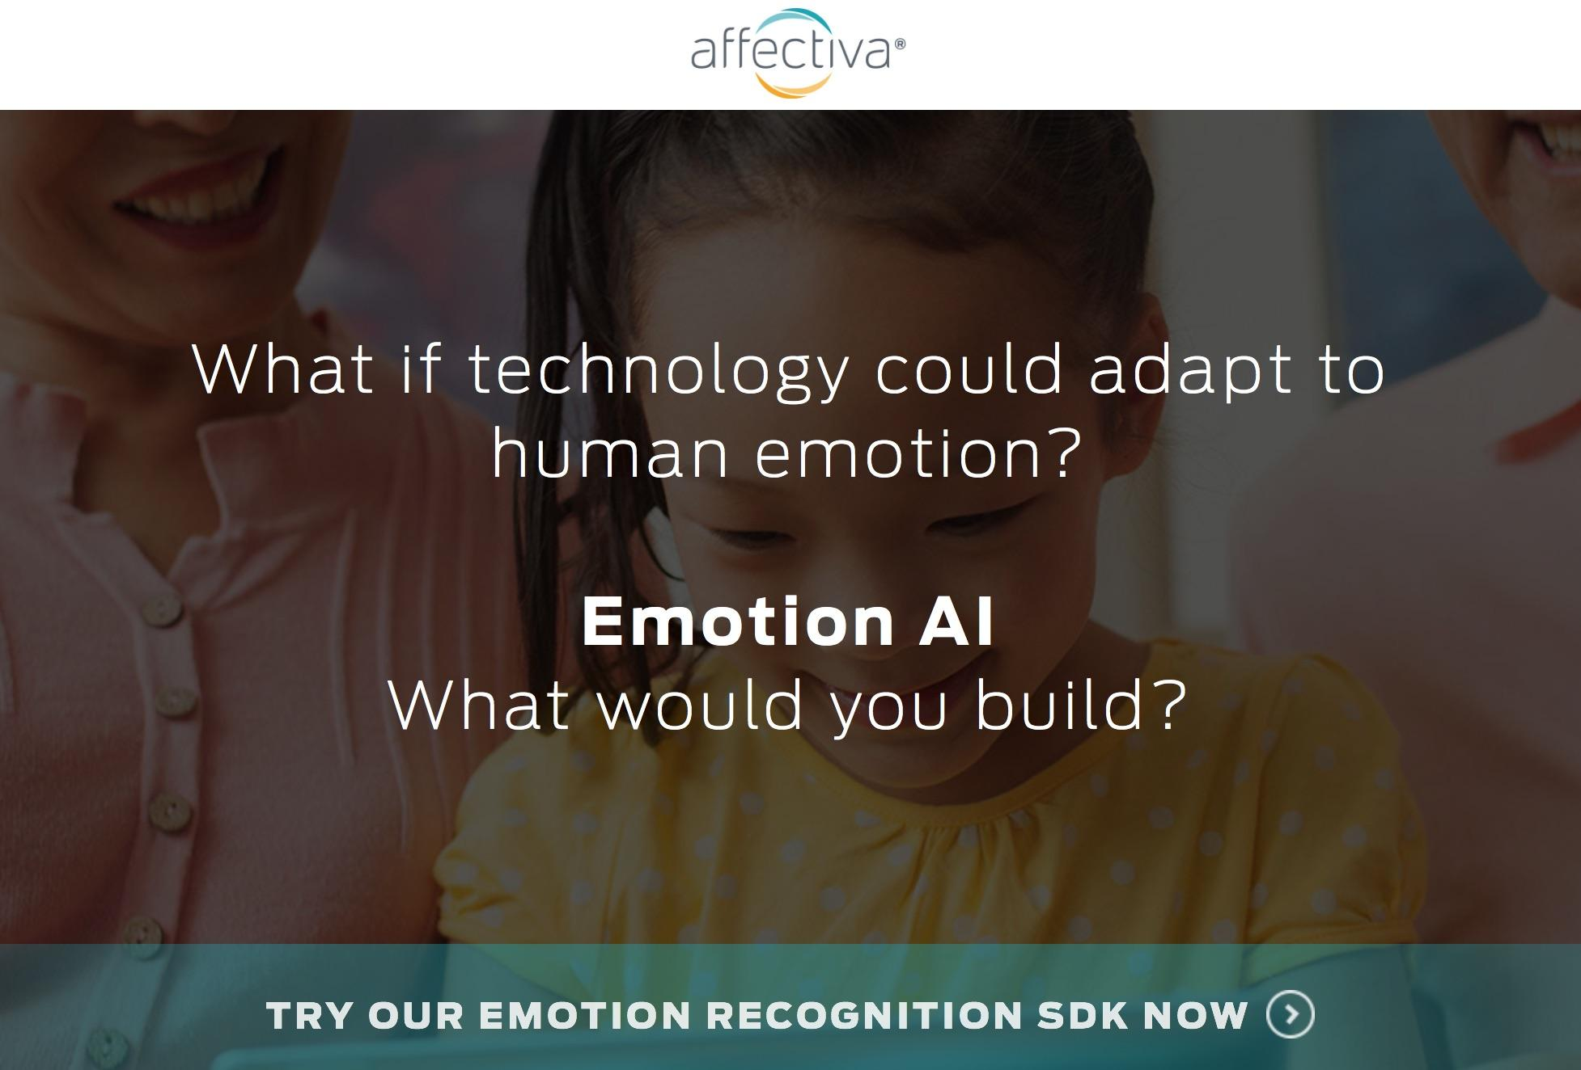
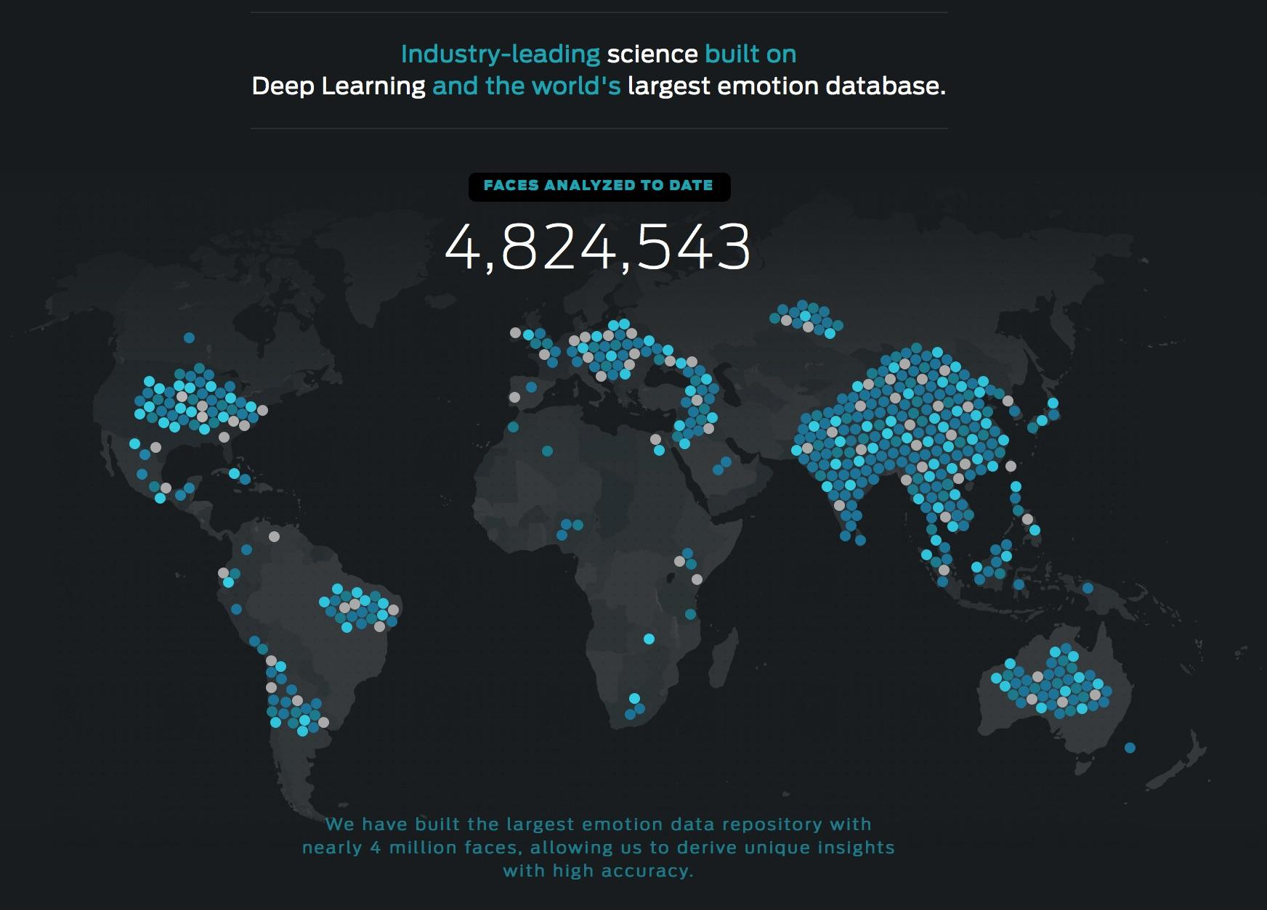
Tracking gestures and key points on the subject’s face, Affdex is able to analyze subtle movements and correlate them with complex emotional and cognitive states. This is much more than simple facial recognition. The Affdex system can identify and follow dozens of precise locations on an individual’s face. The muscular micro-shifts of every smile, yawn, or moment of confusion are captured and reflected in the data.

Slide 20
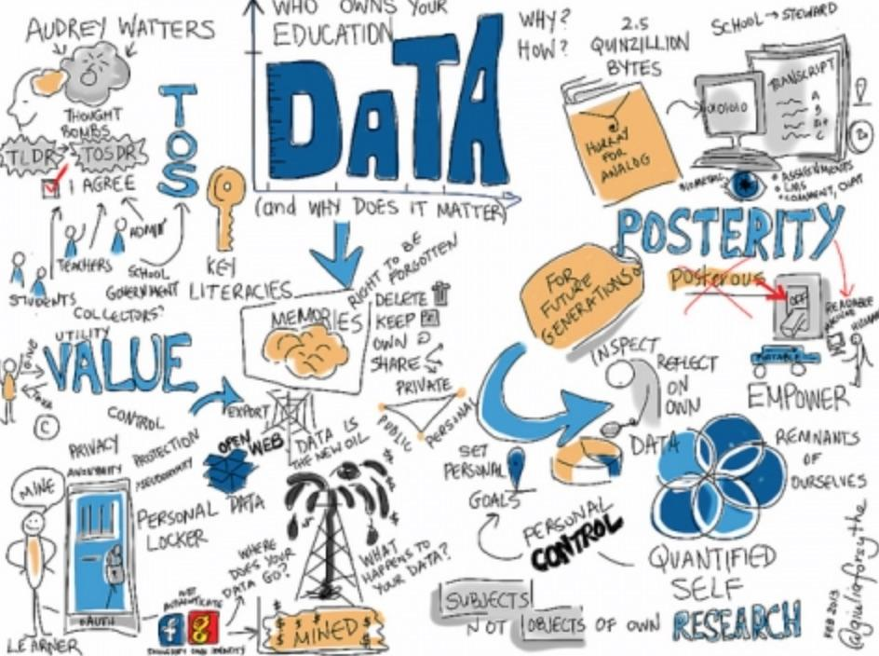
Online Learning
Stealth Data Collection Platform
When is your child’s data is being collected?
Do they know it is being collected?
What data is being collected?
How it is being used?
Could your child’s data limit their opportunities?
Do you know how your child’s data can be disposed of?
Who controls the data? To what end?

Slide 21
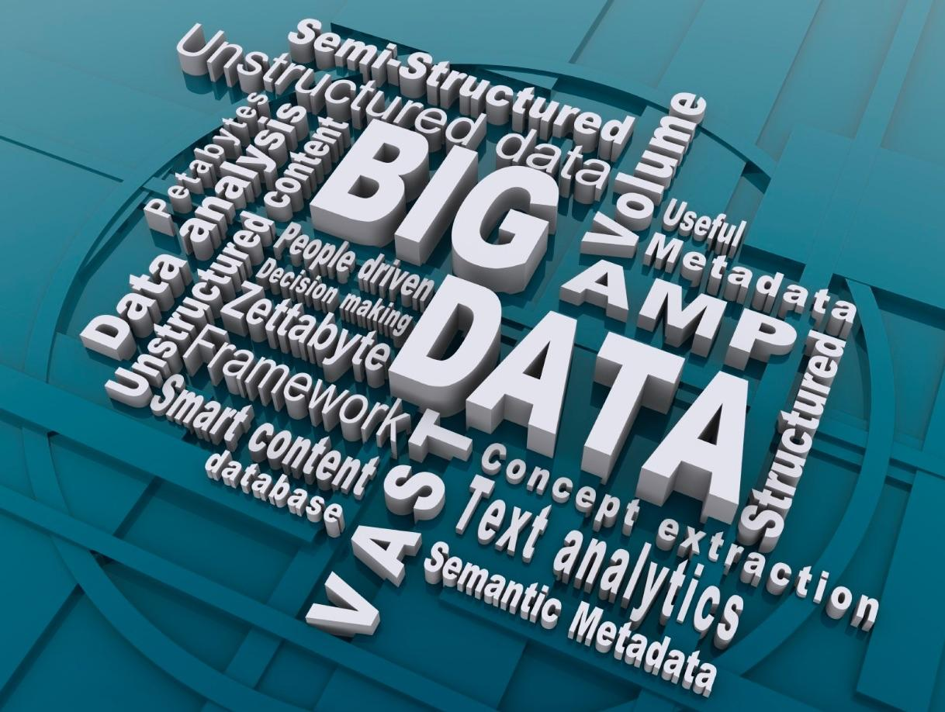
Big Data and Students
Politics and technology are intertwined.
Data is a virtual currency.
Data can be used for social control.
Data can be used to maintain power imbalances.
Data can be used to modify behavior.
Often, data collection is not transparent or under the control of the individual.
The amount of data being collected on students is expanding exponentially.
Education incorporating the “secret rules” of algorithms is a social justice issue.

Slide 22
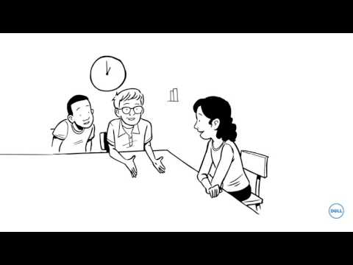
Dell is creating personalized learning options.
One of Dell’s major clients is the NSA.

Slide 23

Are we approaching a time when school buildings with teachers are no longer the norm?

Slide 24
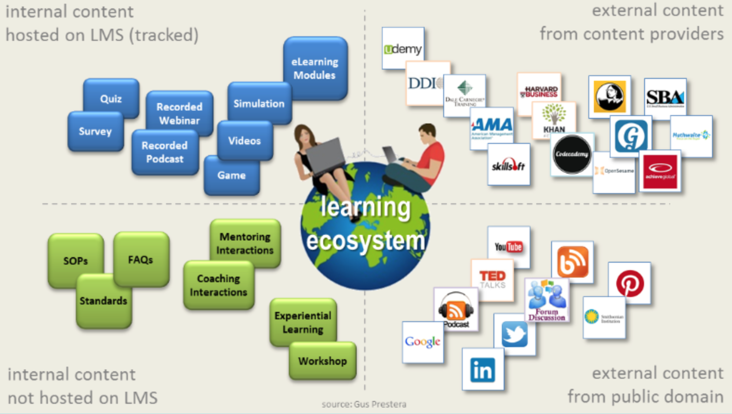
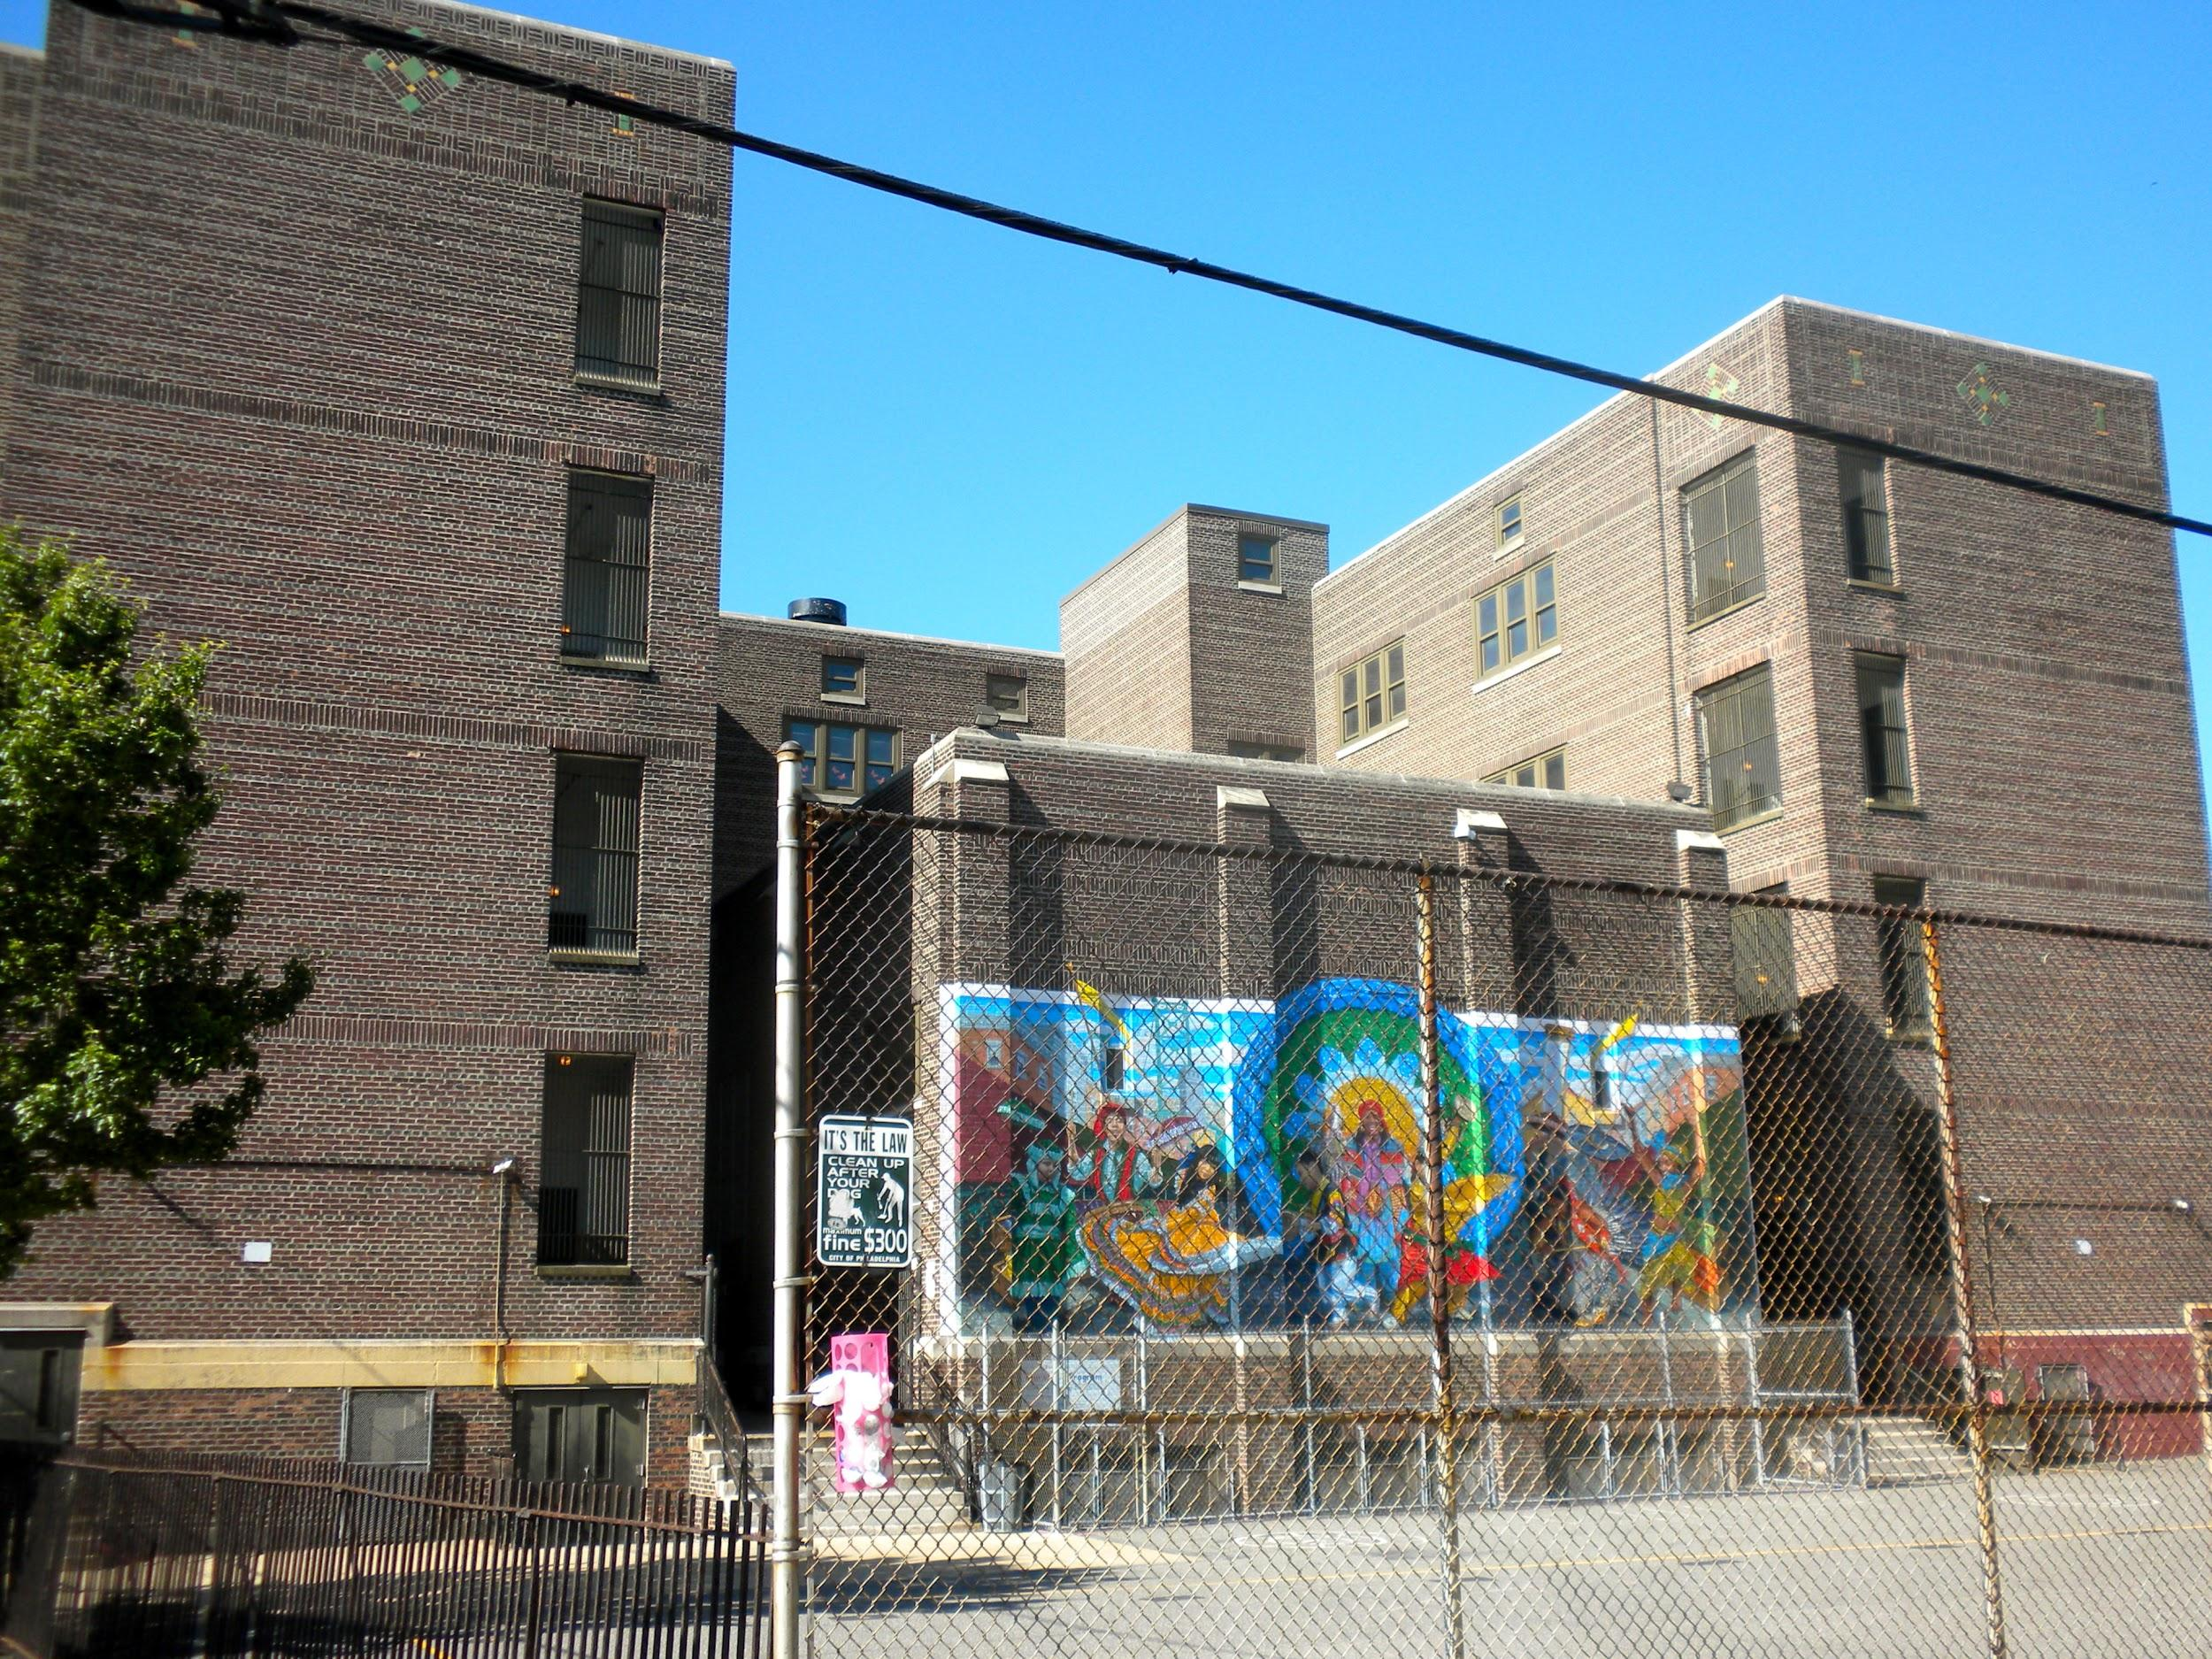
We are being moved from neighborhood schools
to learning ecosystems.

Slide 25
Here are some of the strategies:
Enforce Ongoing Austerity Budgets | Increase Reliance on Public-Private Partnerships | Manufacture Teacher Shortages & Push Out Veteran Educators | Use Hybrid-Blended Programs to Increase Class Size | Limit Access to Text Books / School Libraries
Install Reform-Minded, Alt-Cert Administrators | Script Teaching Push Corporate PD | Control Teacher Training Programs | Cultivate Climate of Fear and Competition | Prioritize Data Over Human Relationships
Ramp Up No Excuses Discipline & Increased Surveillance | Allow School Facilities to Deteriorate Beyond Repair | Cut Recess Scale Back Electives | Limit School-Based Extra Curricular Activities | Limit Public Participation in Ed Policy Decisions
Districts Create Their Own Online Course Offerings | Prioritize Broadband Infrastructure Investments | Push Idea That Learning Happens Outside School | Establish Community Makerspaces / Drop In Centers | Push the Narrative that Schools Cannot be Fixed

Slide 26
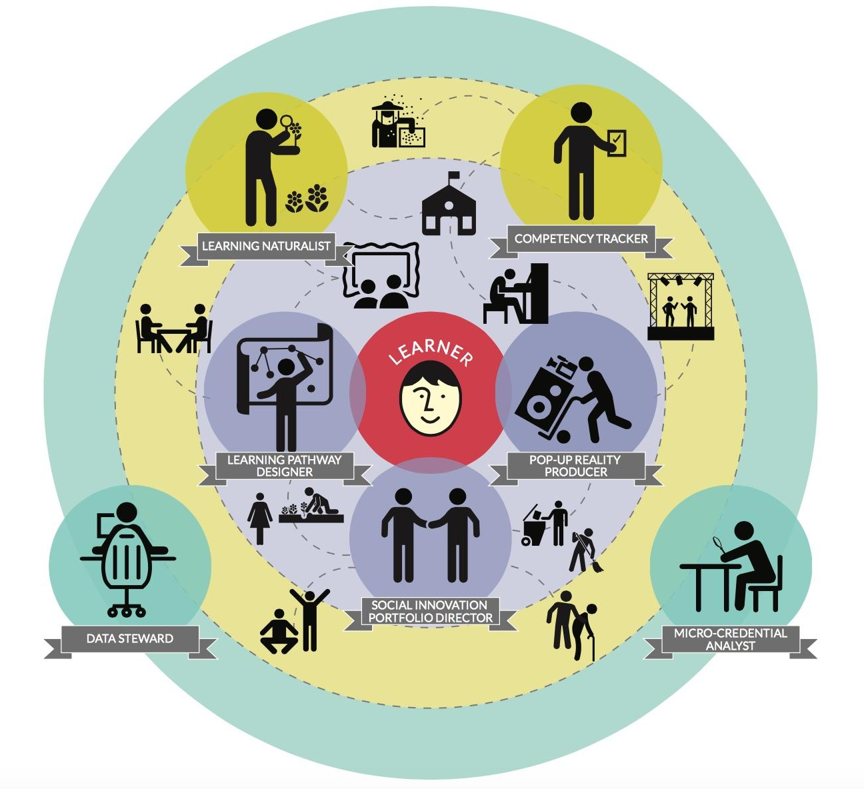
In the learning ecosystem, certified teachers could be replaced by...
Gig Economy
Benefits?
Data Stewards
Learning Pathway Designers
Competency Trackers
Learning Naturalists
Pop-Up Reality Producers
Micro-Credential Analysts
Social Innovation Portfolio Directors
Turnover & Churn
No Time to Build Lasting Relationships
Exploring the Future Education Workforce: New Roles for An Expanding Learning Ecosystem, Knowledgeworks 2015

Slide 27
Earning credit in your community. What are ELOs?
Guidelines for awarding ELO credit (ELO=Extended-Expanded-Enhanced-Enriched Learning Opportunity)
ELOs can provide credit in any discipline. Flexible NH rules give school boards and districts permission to:
award quarter, half, and/or full credit
have interdisciplinary ELOs that provide multiple credits in multiple content areas
introduce ELOs as a way of expanding electives, and later shift into offering core credit as well
link duration of ELOs to mastery of competencies rather that semester or quarter end dates
Under the state’s Extended Learning Opportunity Program, students in the Manchester School District could earn school credit for any of the following:
Volunteering with the school district’s “IT” support team.
Working at an after-school job.
Going to a rock-climbing gym.
Travel during summer vacation.
Giving swim lessons.

Slide 28
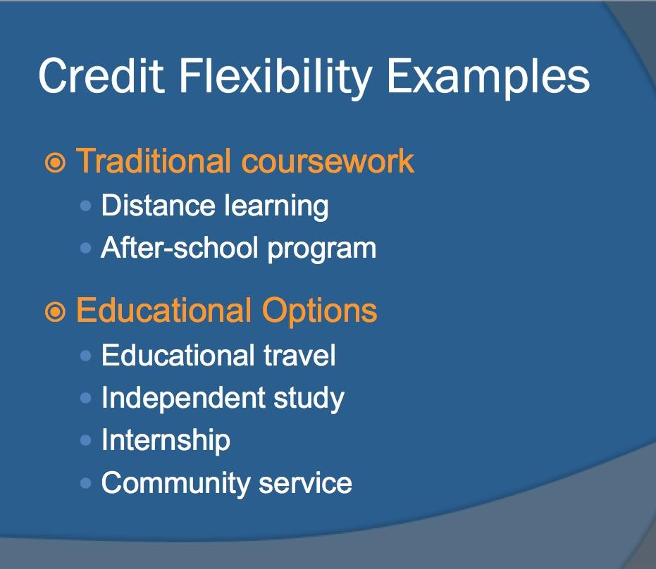
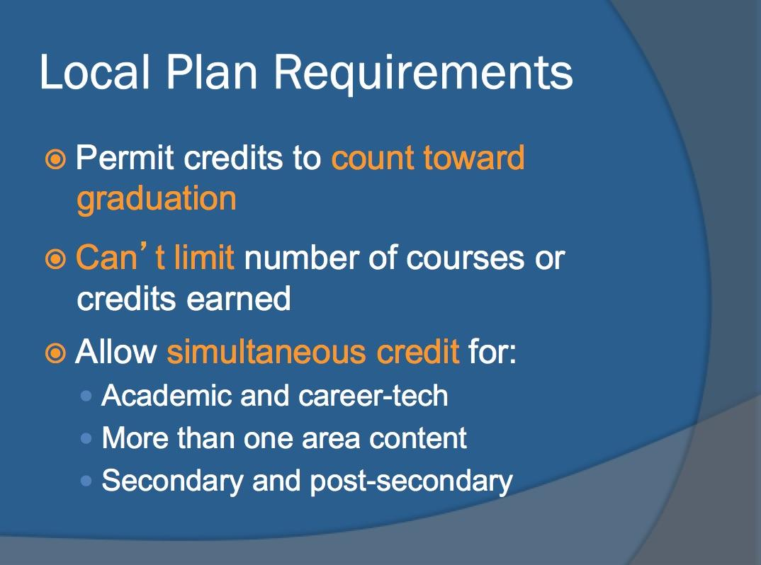
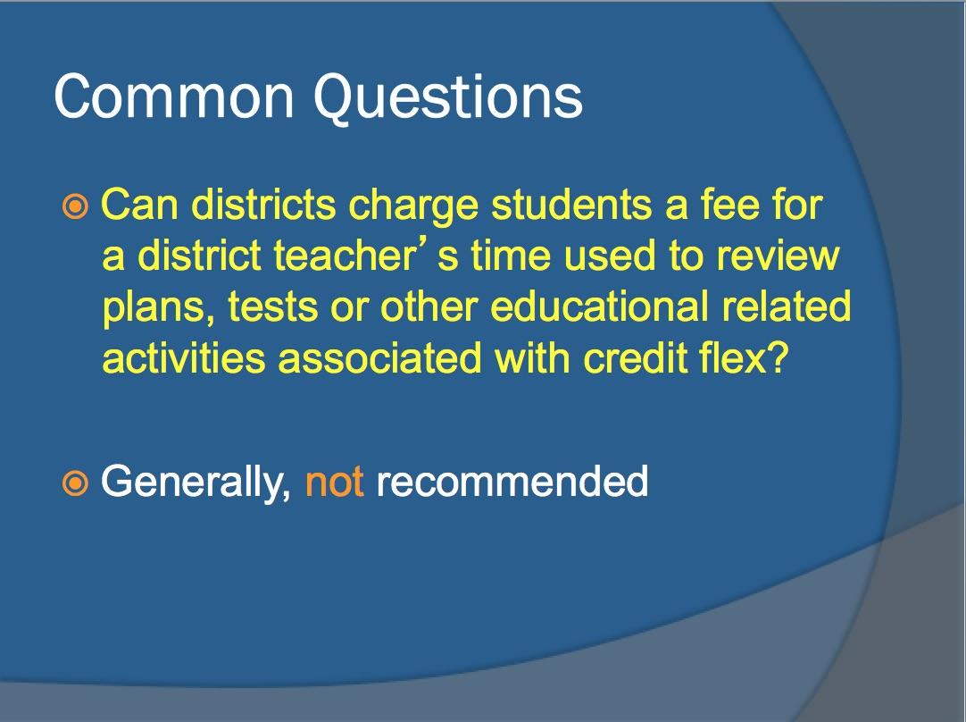
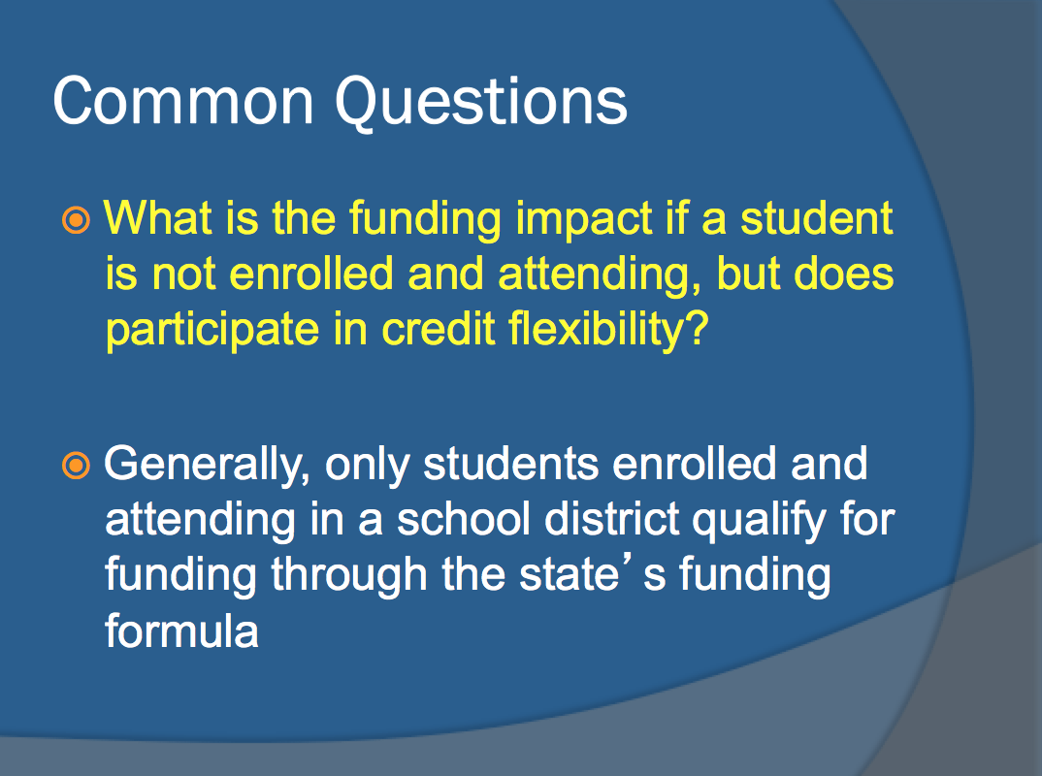
Ohio Credit Flexibility Legislation

Slide 29
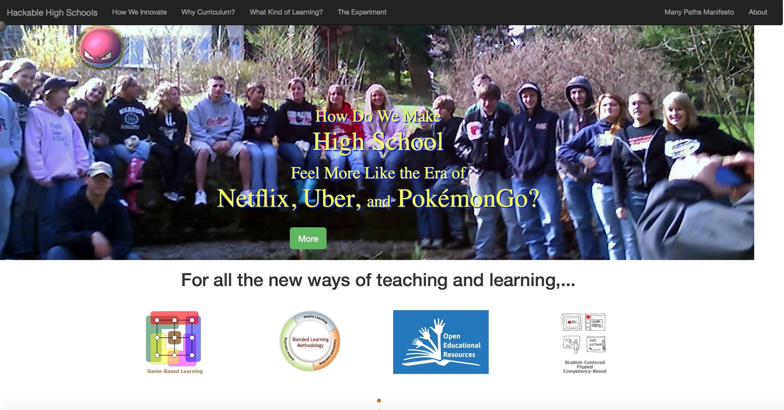

Slide 30
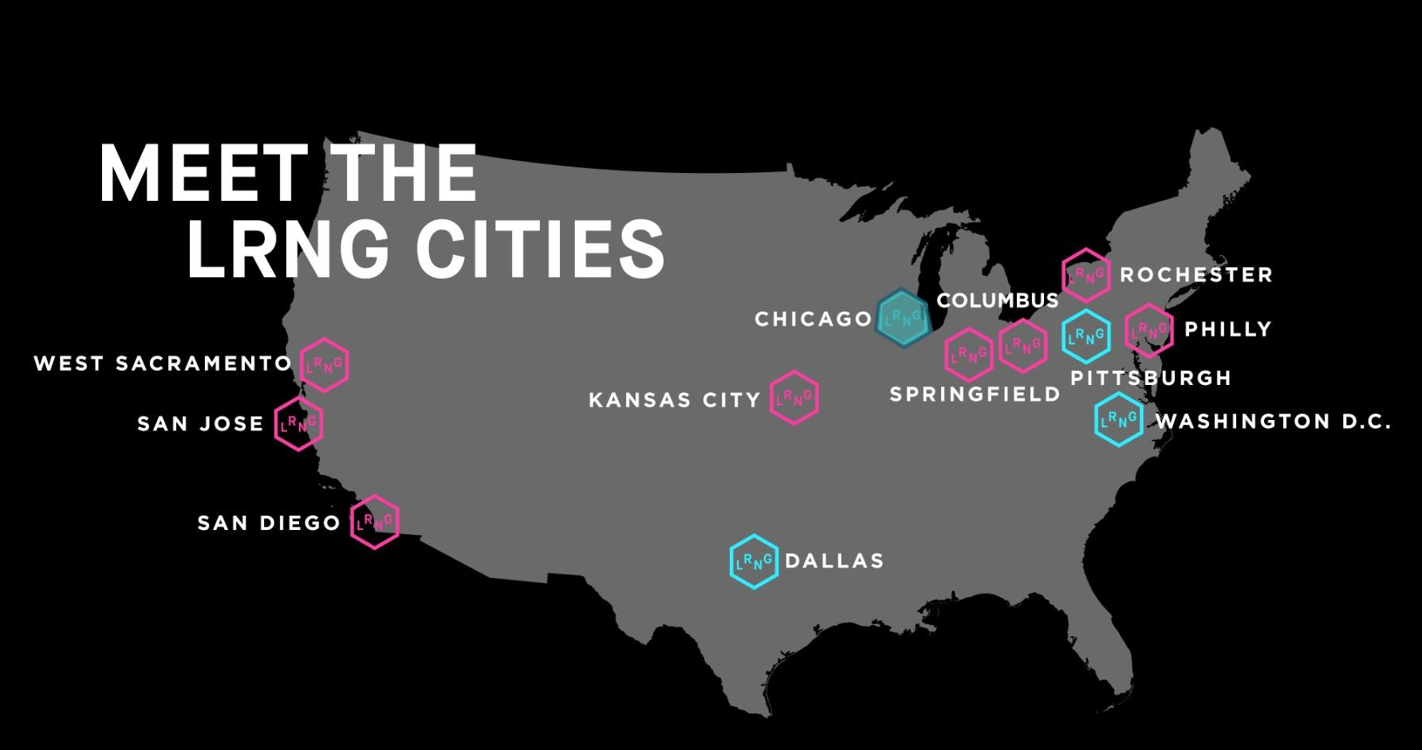
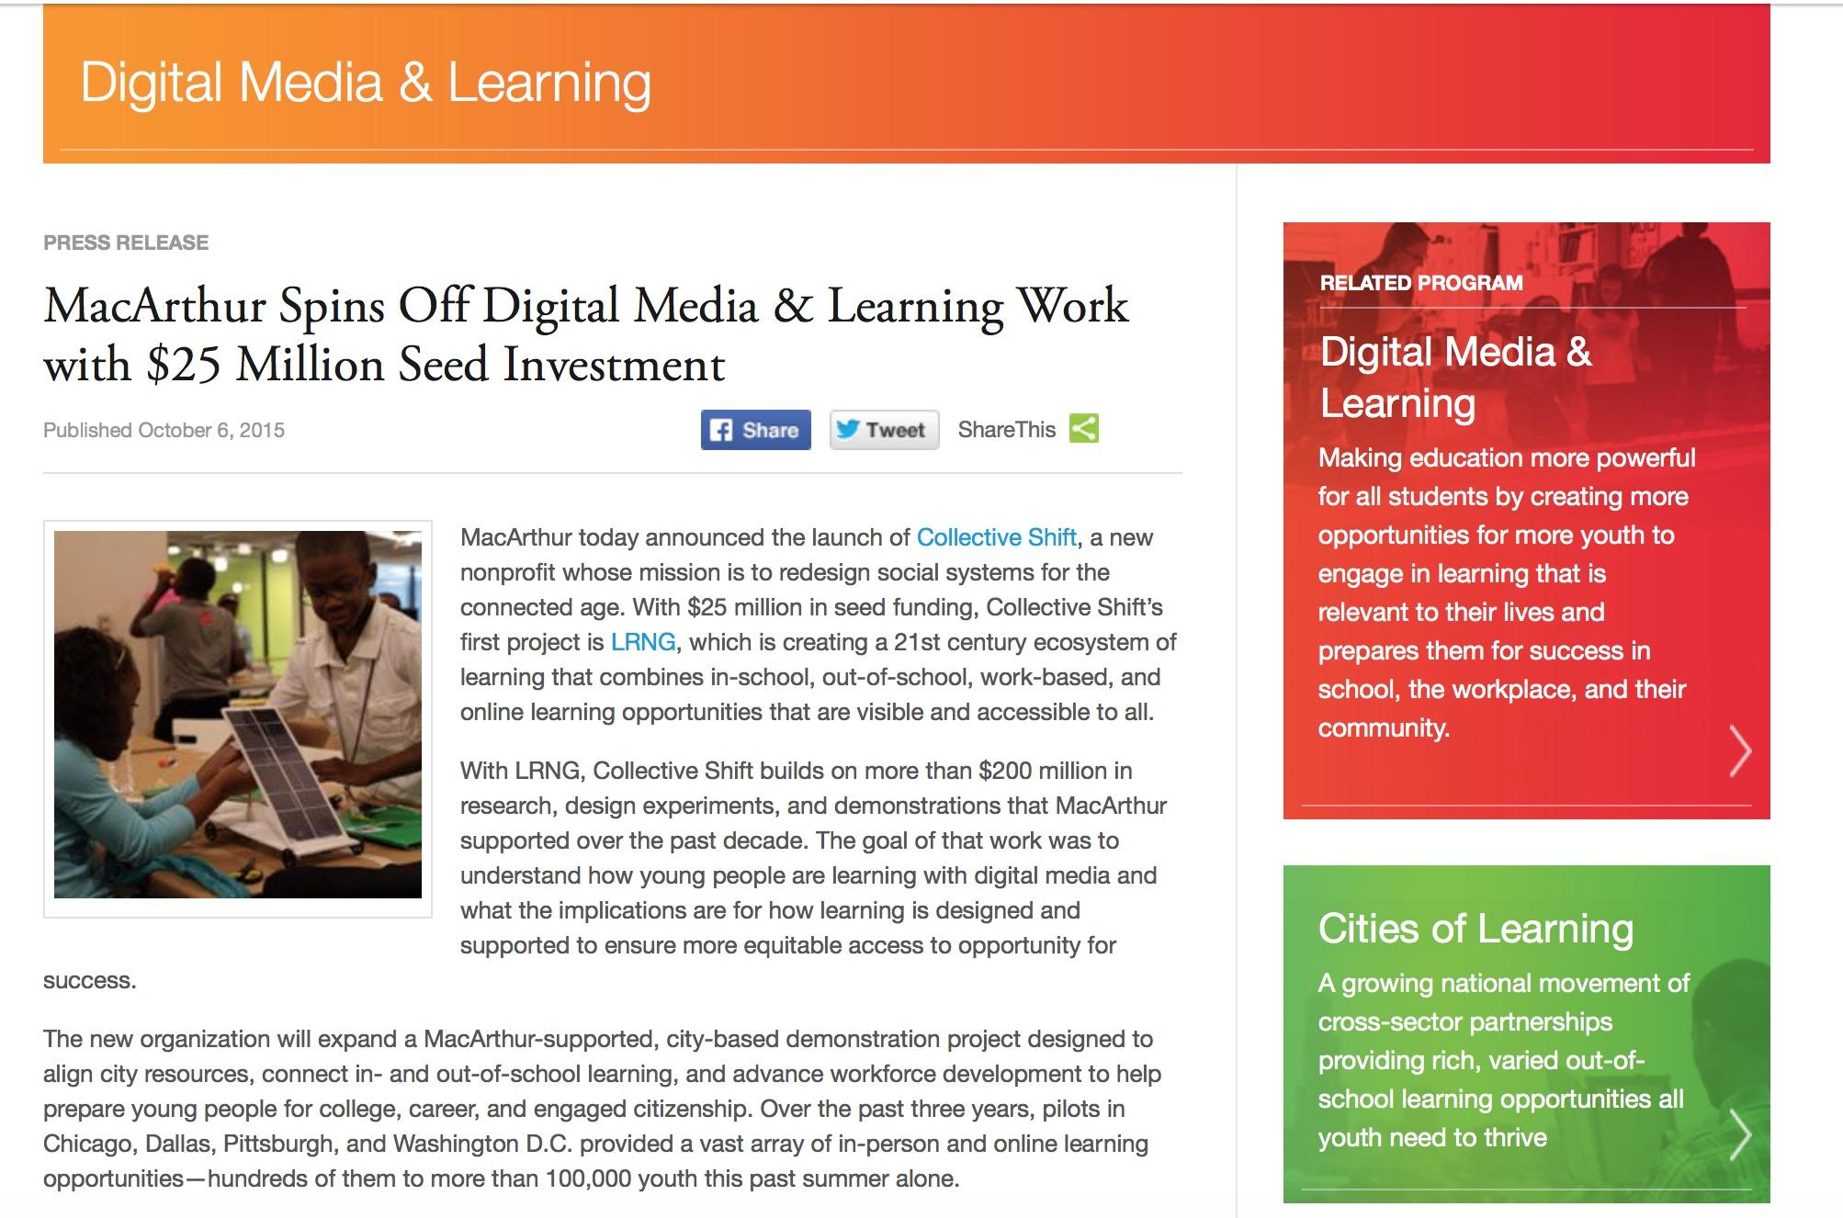
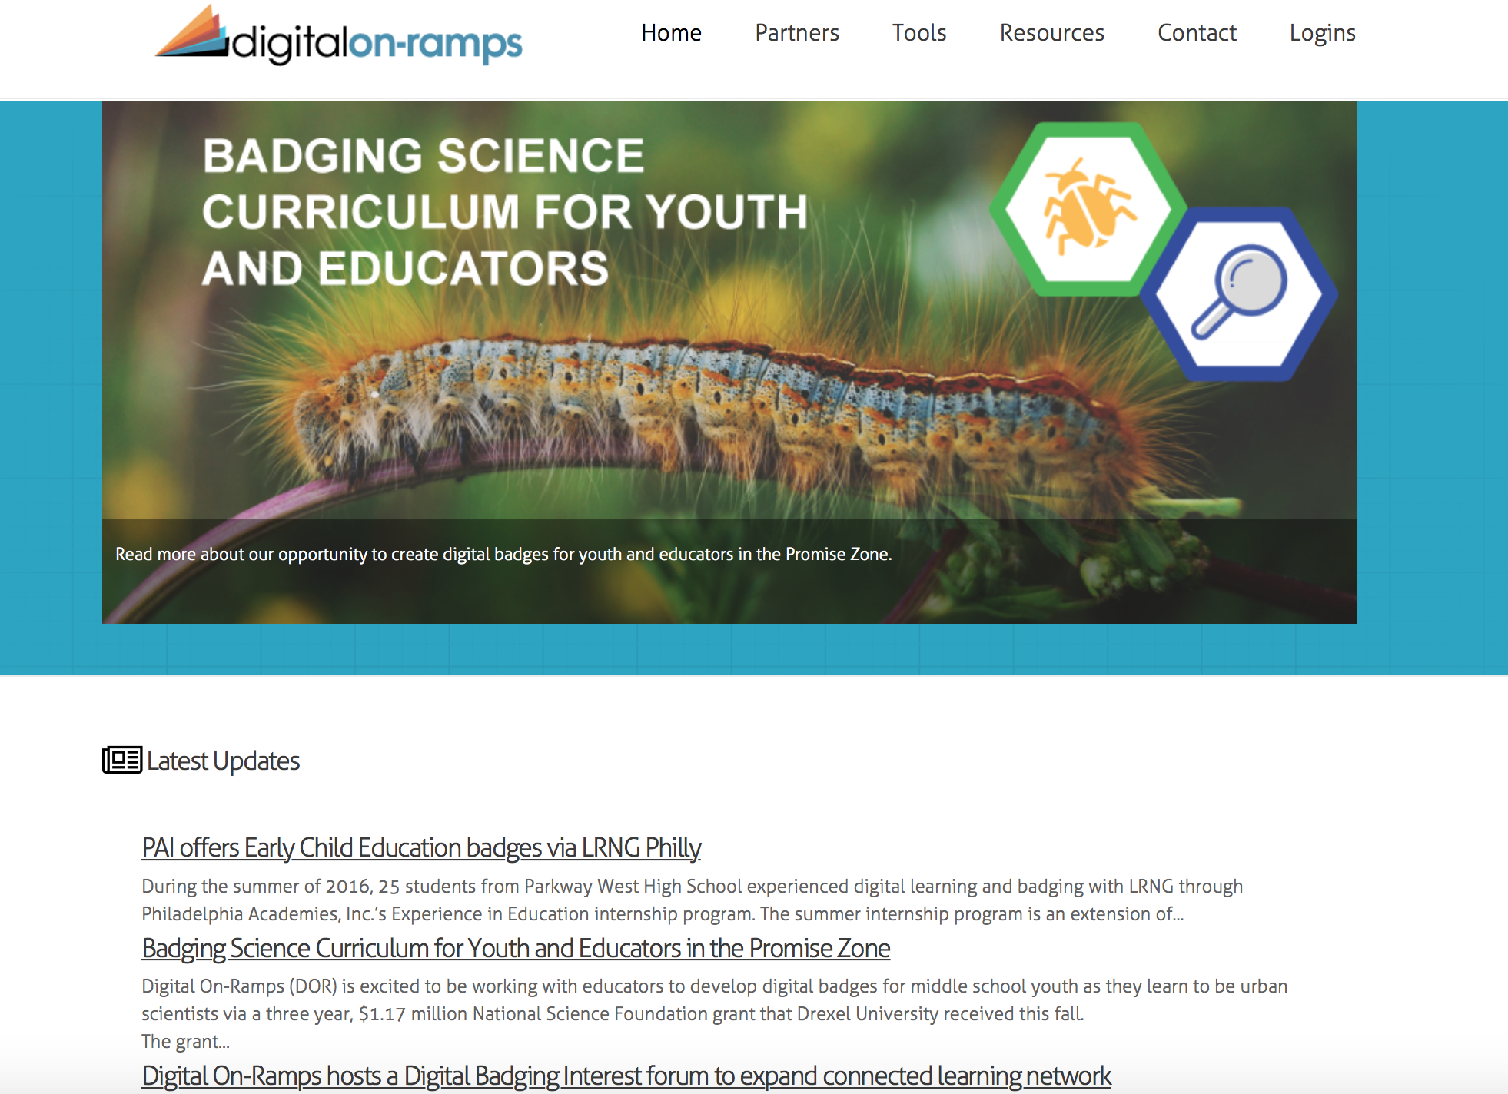
What’s happening in Philadelphia?

Slide 31

DeVos * Vouchers * Value Schools
Education Savings Accounts *Arizona Debit Cards Blockchain/Bitcoin
Credential Verification
E-Portfolio of Badges/Skills
Virtual Wallets
Separate Payments
Multiple Transactions
Smart Contracts
For-Profit Online Options
Private Options
Community-Based Options

Slide 32
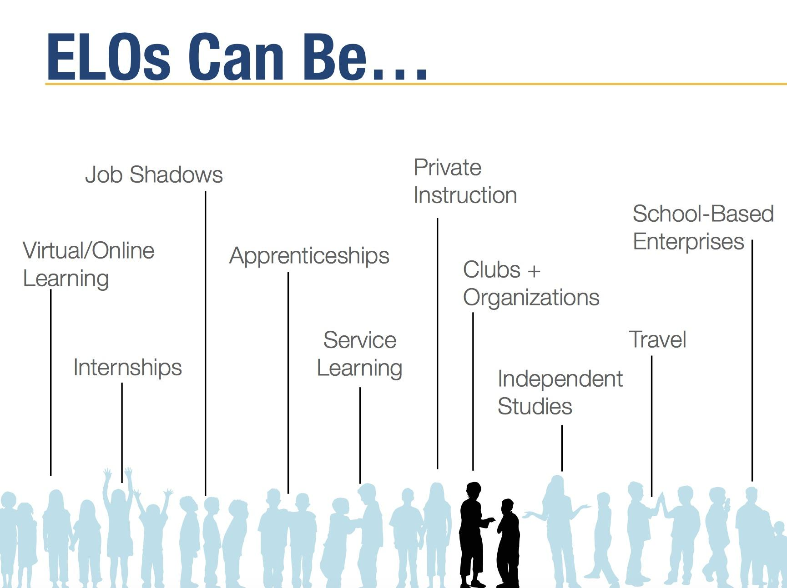
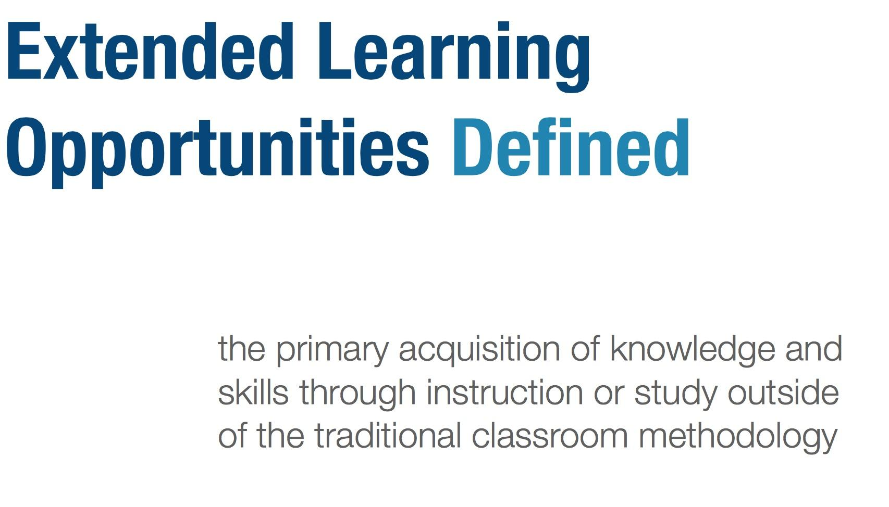
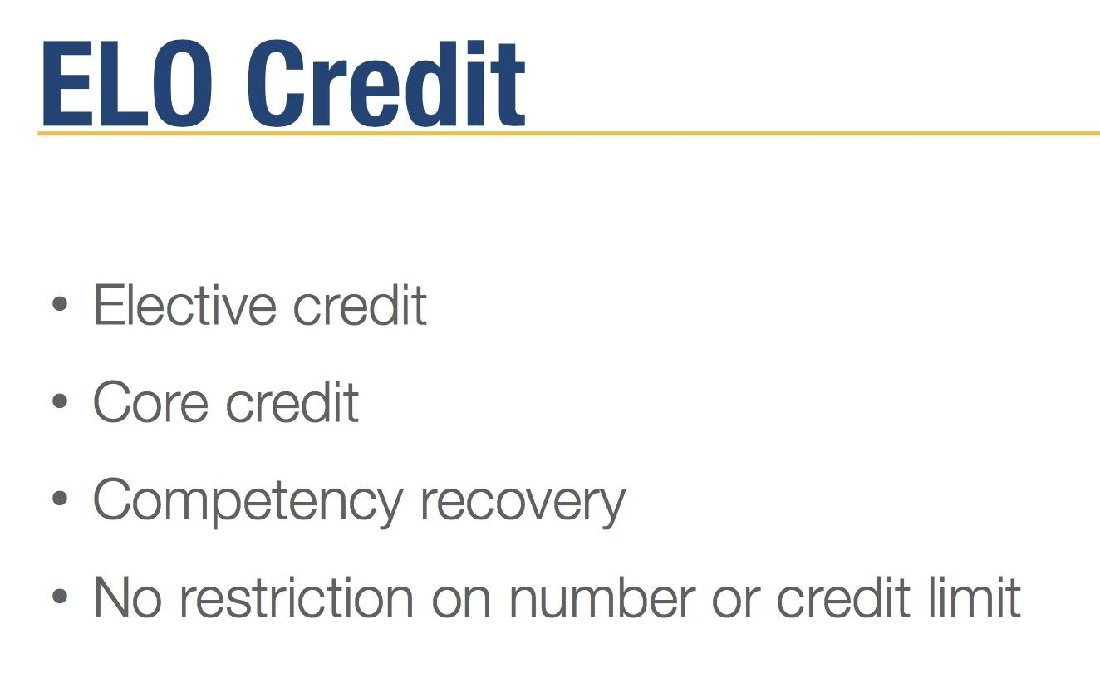
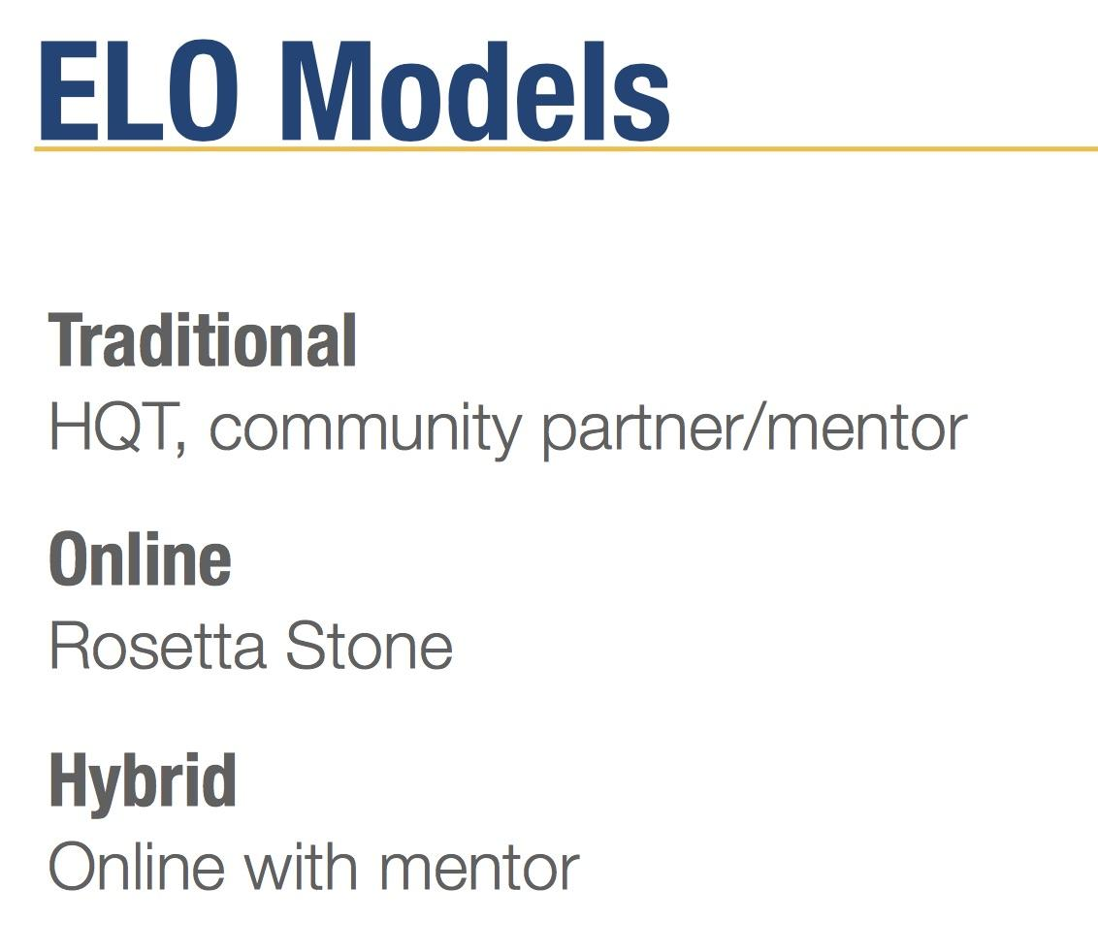
ELOs can also be cyber education.
“Keeping it Flexible: Extended Learning Opportunities in Today’s High Schools”
Great Schools Partnership, Webinar Series, 2014

Slide 33
ALEC’s Recent Digital Education Activities
STATEWIDE ONLINE EDUCATION ACT: creates a statewide program that provides high school students with access to online learning options regardless of where the student lives. The options are designed to be high quality and allow for maximized learning potential by focusing on student mastery of subjects at their own pace and own time, instead of the traditional seat-time learning requirements. Amended January 2016
DIGITAL TEACHING AND LEARNING PLAN: requires the State Board of Education to develop a digital teaching and learning plan to prepare the state to implement a statewide initiative that will result in dramatic improvements in student achievement. Finalized January 2016
ONLINE LEARNING CLEARINGHOUSE ACT: creates a clearinghouse through which school districts may offer their computer-based courses to students of other districts. Amended January 2016
NEXT GENERATION CHARTER SCHOOL ACT amendment passed in September 2016 eliminates special distinctions between virtual and non-virtual charter schools. Amended September 2016
RESOLUTION ON STUDENT CENTERED ACCOUNTABILITY SYSTEMS including “timely provision of student-level data, measure student-specific progress and restore the focus of high-stakes testing to be on advancing individual student instruction and growth.” Finalized September 2016

Slide 34
Knowing the poor track record of cyber charter schools,
why should we agree to hand over blocks of instructional time in neighborhood schools to hybrid-blended online learning?

Slide 35
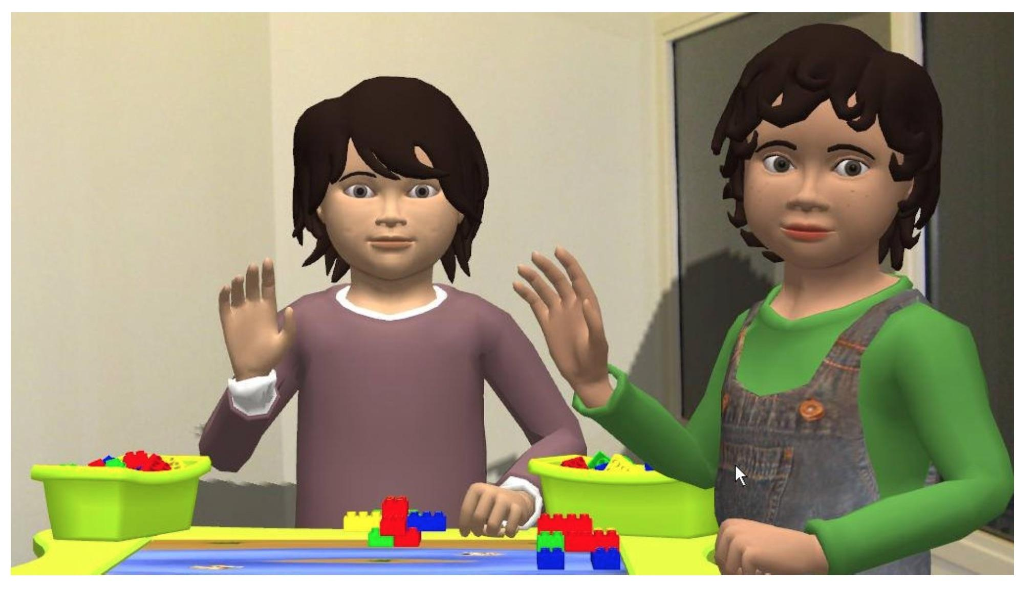


Genie, Reasoning Mind
Who’s teaching our kids?
Articulab Virtual Peers, Carnegie Mellon
TutorMate is funded, in part, by Haliburton and Booz Allen Hamilton

Slide 36
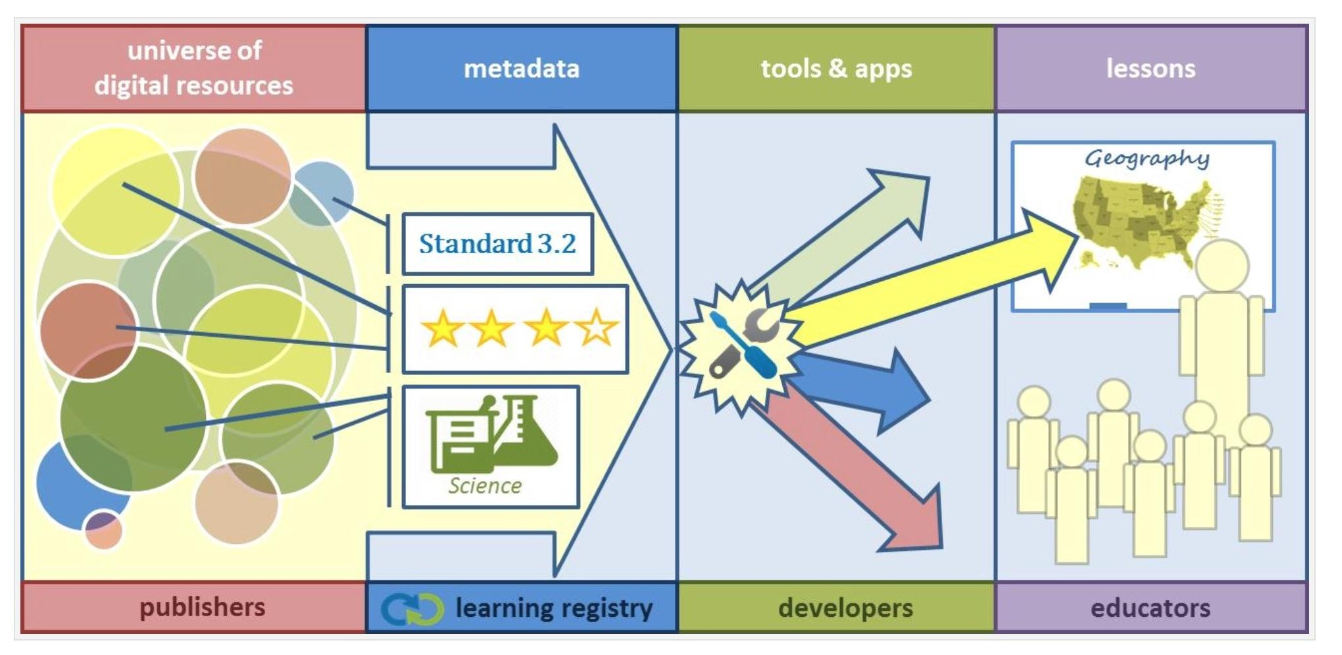
DoD’s ADL Initiative & Department of Ed Create the “Learning Registry”
“The LR is an open source technology framework to which any learning content providers (e.g., teachers, publishers, and curriculum developers) are able to share their content. Users are able to provide specific comments about which content they use, how they use it, and the efficacy of the content. Educators are then able to search within the LR by subject or standard. They can review and choose the most relevant and highly rated resource to present to their students.
The LR is a joint project between the U.S. Department of Education and Department of Defense’s ADL Initiative.”

Slide 37
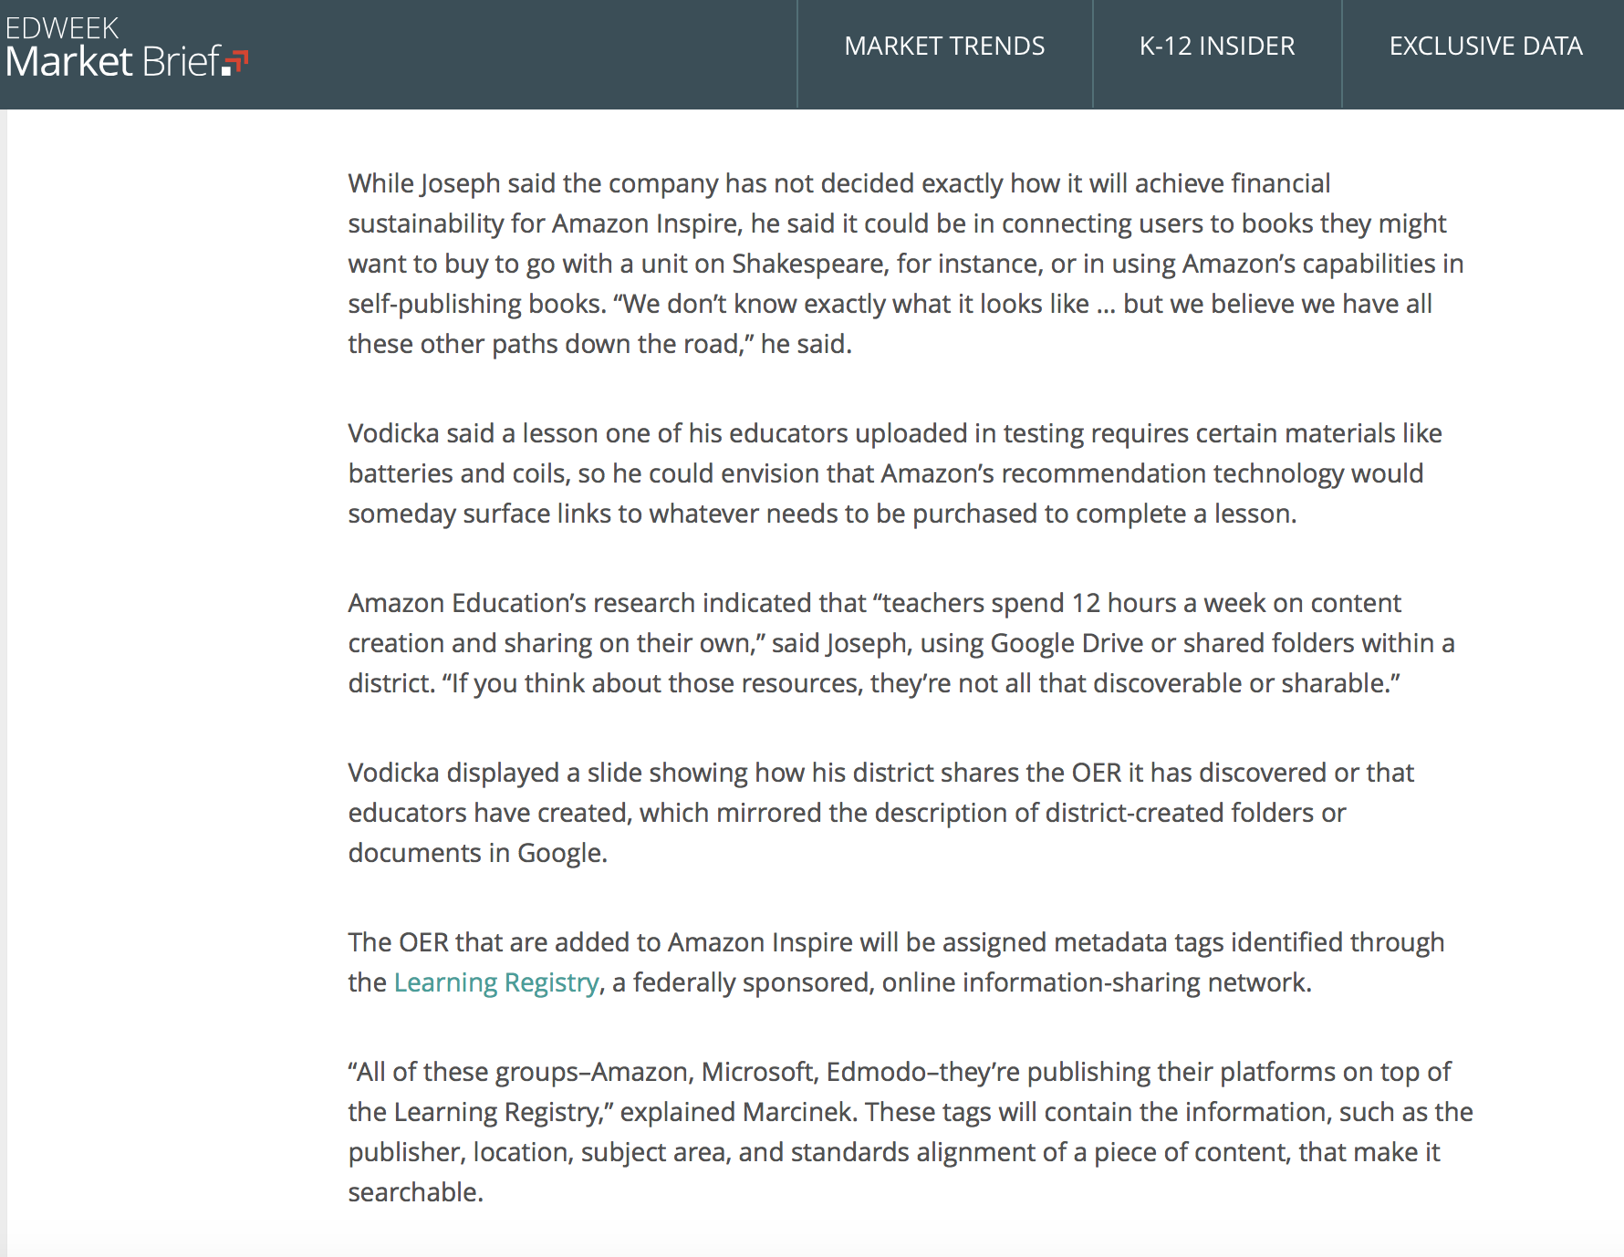
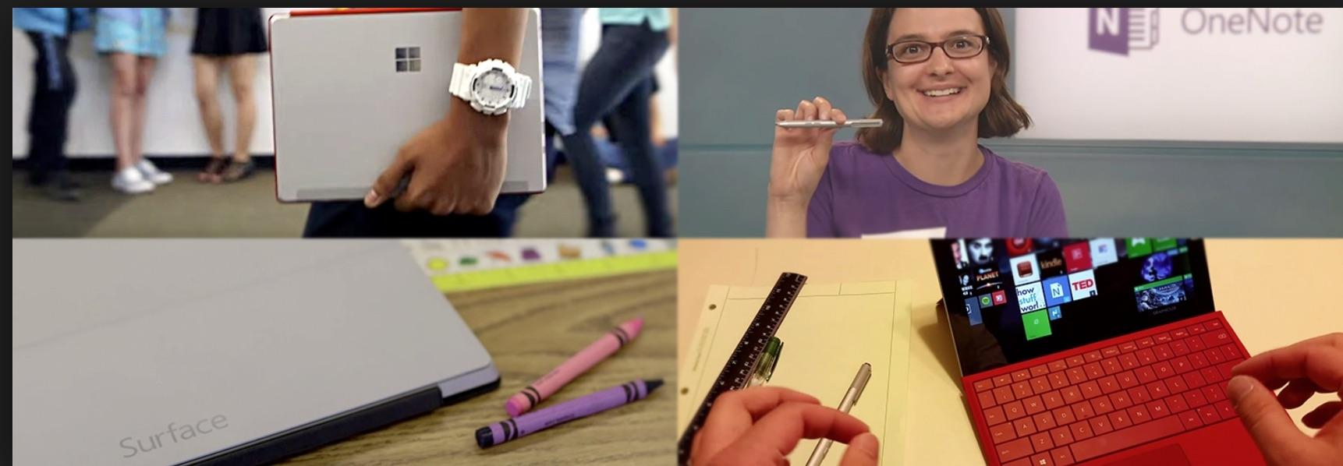
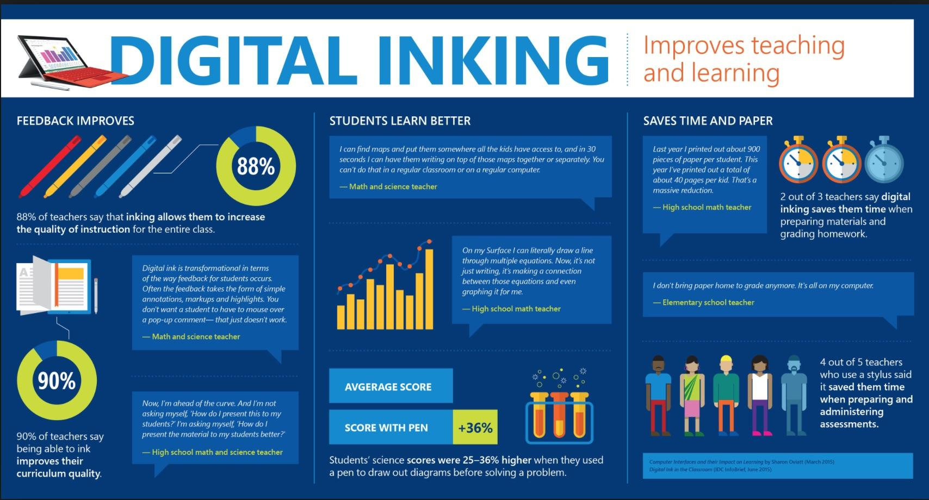
Microsoft Surface

Slide 38
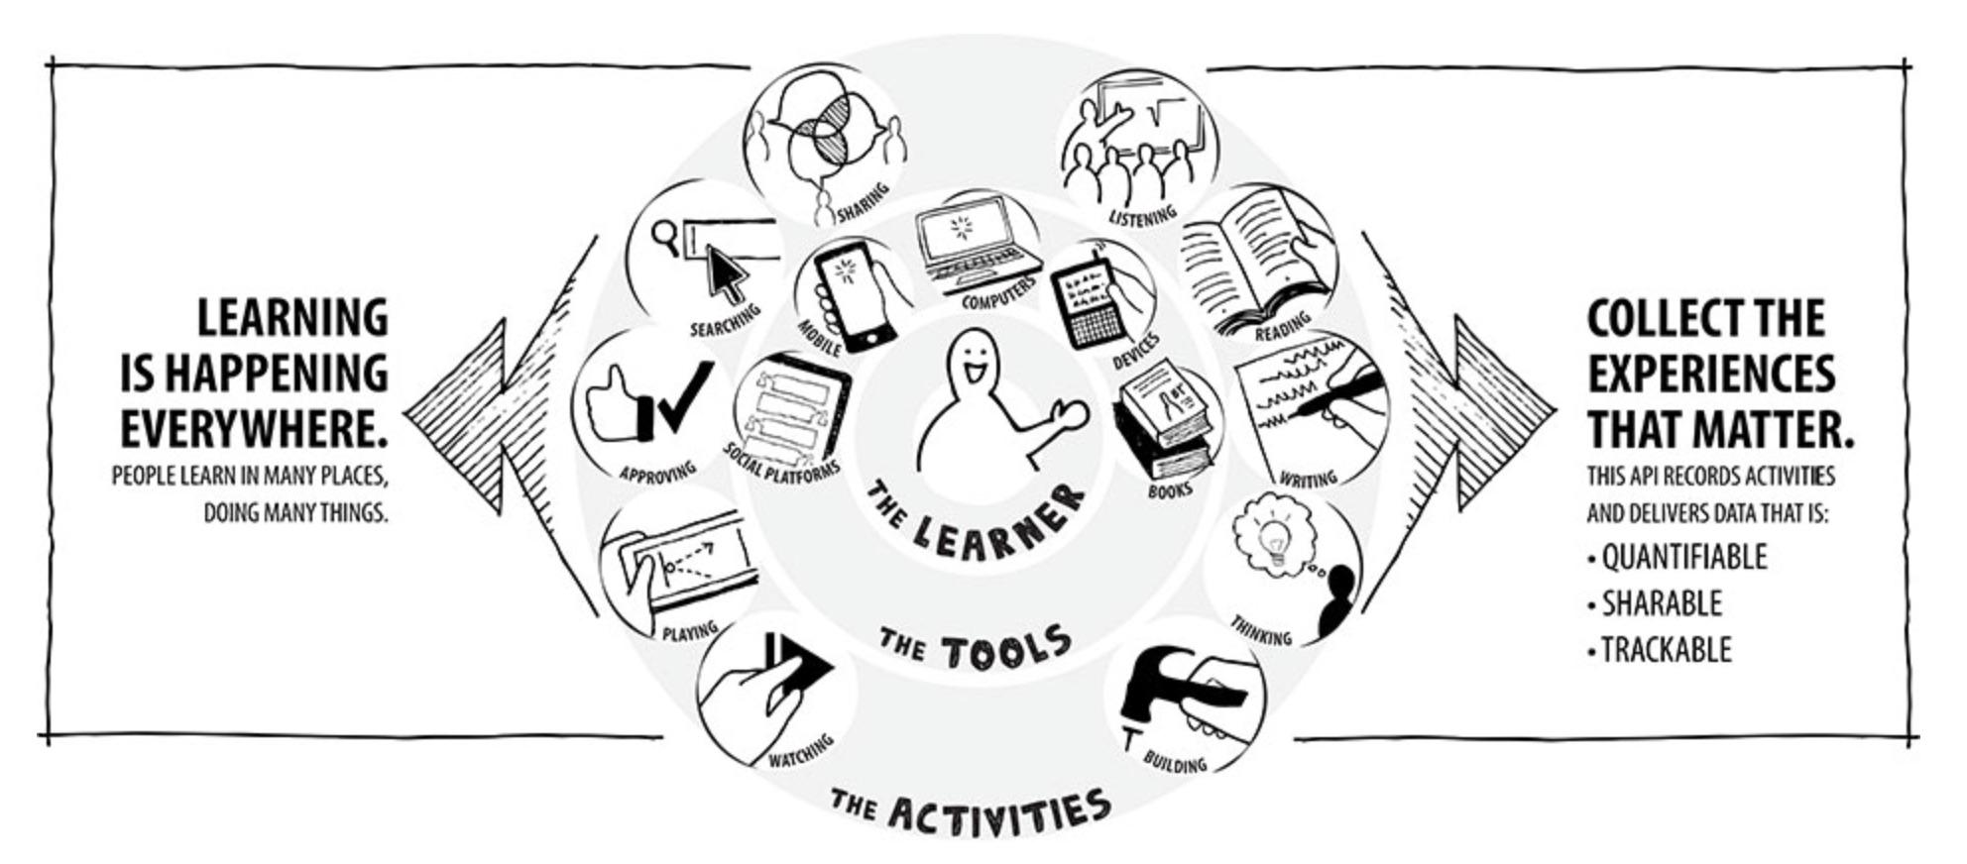
Expansion of ADL to Include Live Data Streams
“Broadly defined, the Experience API (xAPI) lets applications share data about human performance. More precisely, xAPI lets you capture (big) data on human performance, along with associated instructional content or performance context information. xAPI applies human (and machine) readable “activity streams” to tracking data and provides sub-APIs to access and store information about state and content. This enables nearly dynamic tracking of activities from any platform or software system—from traditional Learning Management Systems (LMSs) to mobile devices, simulations, wearables, physical beacons, and more.”

Slide 39
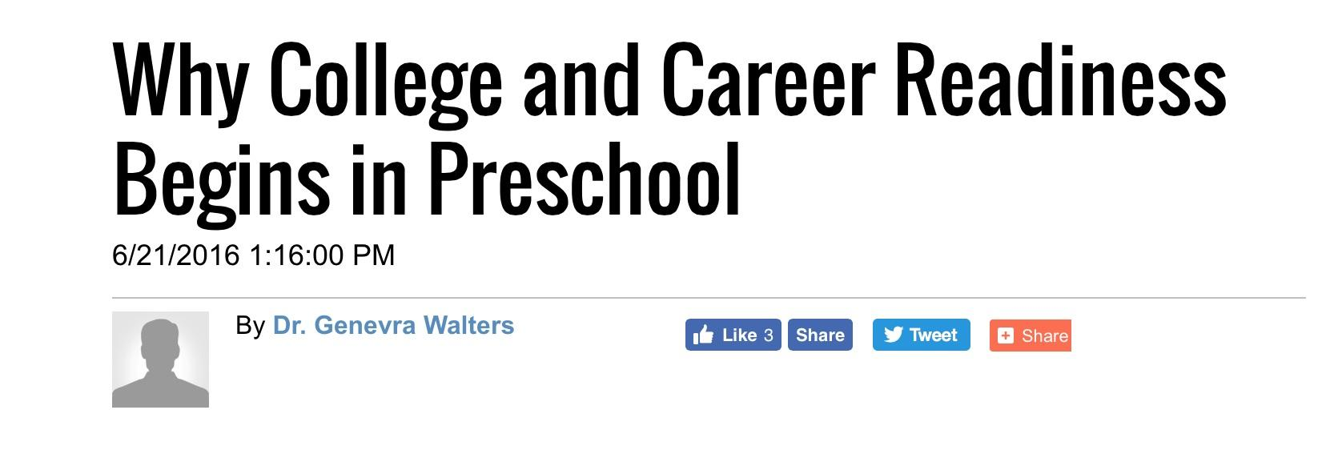
ELOs & Workforce Training
Students today are encouraged to identify career pathways as early as middle school. By high school many are supposed to have Individual Career & Academic Plans in place.
Increasingly, children are viewed as human capital to meet the needs of the economy.
Education now emphasizes acquisition of skills over exercising intellectual curiosity.
ELOs are consistent with workforce training, since many of these “learning opportunities” involve a career component. It also provides a means whereby a student’s “soft skills” can be assessed and documented in a project-based setting.
There is great pressure to lift restrictions on sharing student records across federal agencies and to research institutions, so as to facilitate the flow of education-workforce data.

Slide 40

This is our future if we don’t start speaking up.
Building the Future of Education, p. 12
“If, in the future, more of our children grow up to be TaskRabbits, that may affect the kind of education, training and real-world experience they need to succeed in the odd-job workforce.”
This video was produced in partnership with “Institute for the Future” a RAND spin-off from the 1960s. Despite the somewhat corny nature of the acting IFTF has many high-powered partners.

Slide 41
If you are interested in reading more thoughts on digital education by a skeptical parent, visit:
A Wrench In The Gears

