Slide 1
Independent analysis of quality issues of the BNT162b2 BioNTech/Pfizer Vaccine identified by the European medicines agency
LM Gutschi, BScPhm, PharmD Oct 26, 2022

Slide 2
European medicines agency (EMA)
Regulators all work from Common Technical Document (eCTD)
Rolling review assessment as data became available
Pivotal trial (Polack et al NEJM) published November 2020
BioNTech/Pfizer approved under Conditional Marketing Authority Dec 20, 2020
Leak of confidential documents to “dark web” Jan 2021
L. Maria Gutschi, BScPhm, PharmD

Slide 3
STEPS in Manufacturing
280 components
Several different manufacturing plants
25 different suppliers
Ultra-cold storage
Rapid transportation between sites
https://www.citizen.org/article/how-to-make-enough-vaccine-for-the-world-in-one-year/
L. Maria Gutschi, BScPhm, PharmD

Slide 4
The mRNA is synthetic and modified
https://www.sec.gov/Archives/edgar/data/1682852/000168285221000006/mrna-20201231.htm
Aberrant protein production
Misfolding of protein
Errors on translation
Protein cell signalling
Homology with human proteins
Autoimmunity risk
Cancer risk
Neurotoxicity risk
Kim, S., Sekhon, S.S., Shin, WR. et al. Modifications of mRNA vaccine structural elements for improving mRNA stability and translation efficiency. Mol. Cell. Toxicol. 18, 1–8 (2022). https://doi.org/10.1007/s13273-021-00171-4
L. Maria Gutschi, BScPhm, PharmD

Slide 5
?
Spike protein produced by synthetic mRNA
180kDa
Wuhan spike
141 kDa
https://www.excellgene.com/sars-cov-2-trimeric-spike-protein-wuhan/
L. Maria Gutschi BScPhm, PharmD

Slide 6
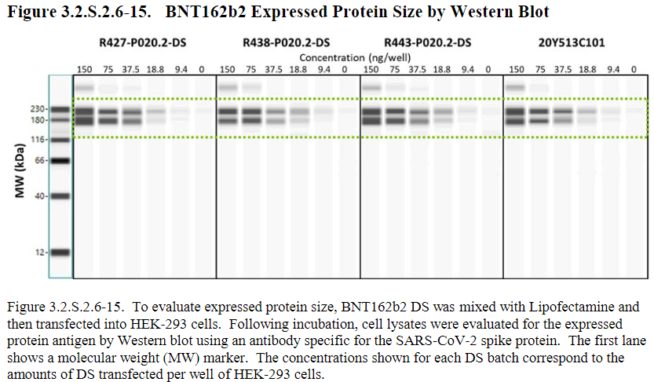
Characterization of spike protein
A severe deficiency of the characterization section is that no biological characterization is presented and that the mode of action is not described. This is not found acceptable and the dossier should be updated with relevant information. Even though full biological characterisation is not possible to perform on drug substance (DS), the strategy to determine potency and relevant functional assay(s) should be described. Results obtained on drug product (DP) could be included, to demonstrate functionality.”
Became a SPECIFIC OBLIGATION 1 on CMA Dec 20, 2020
Still not met Dec 2021
Granted Feb 2022
L. Maria Gutschi, BScPhm, PharmD

Slide 7
In communications with Moderna and Pfizer-BioNTech regarding the proteins expressed by their synthetic mRNA vaccines, each company’s medical information group disclosed that that they had not examined the protein dynamics more than 48 hours post-transfection in cell culture. Owing to its proprietary status, they would not disclose any information related to the nature of the protein that was expressed.
Time is right to left
Western blot of NIH 3T3 (top) and U937 (bottom) cell extracts using mouse monoclonal antibody directed against SARS-CoV-2 protein at various time points after treating the cells with Spikevax. The REGEN COV antibody does not bind to the SARS-Cov-2 protein in a western blot format, only in a soluble format, see ELISA data, Figure 1.
Veenstra, T. D., Pauley, B., Injeti, E., & Rotello, R. J. (2022). In vitro Characterization of SARS-CoV-2 Protein Translated from the Moderna mRNA-1273 Vaccine. medRxiv, 2022.2003.2001.22271618. https://doi.org/10.1101/2022.03.01.22271618
L. Maria Gutschi, BScPhm, PharmD

Slide 8
The commercial product is not the same as that used in the clinical trials (RNA INTEGRITY)
Batch Analysis for Clinical COVID-19 Vaccine BNT162b2 Drug Substance
PROCESS 1 Batches (BioNTech) used in clinical trials |  |  | R427-P020.2DS | R483-P02.2DS | R443-P020.2DS | R445-P020.2DS
Quality Attribute | Analytical Procedure | Acceptance Criteria
RNA Integrity | Capillary gel electrophoresis | >85% in the peak corresponding to intact RNA | 77 | 80 | 81 | 86
PROCESS 2 Batches (Pfizer, Andover) |  |  | 20Y513-C101 | 20Y513-C201 | 20Y513-C301 | 207513-C501
RNA Integrity | Capillary gel electrophoresis | >50% intact RNA | 62 | 69 | 66 | 75
PROCESS 2 Batches (Pfizer, Puurs) |  |  | ED3938 | EE3813 | EE8492 | EE8493
RNA Integrity | Capillary gel electrophoresis | >50% intact RNA | 63 | 63 | 55 | 55
L. Maria Gutschi, BScPhm, PharmD

Slide 9
Contaminants
Truncated mRNA
Fragmented mRNA
dsRNA
DNA
Are they translated into proteins?
Are they associated with autoimmunity?
https://www.sciencedirect.com/science/article/pii/S0264410X21003194
L. Maria Gutschi, BScPhm, PharmD

Slide 10
Critical Quality Attributes OF THE mRNA
Quality Attribute | Analytical Procedure | Acceptance Criteria
Composition and Strength
Clarity | Appearance (Clarity) ª | ≤ 6 NTU
Coloration | Appearance (Coloration) ª | Not more intensely coloured than level 7 of the brown (B) colour standard
pH | Potentiometry ª | 7.0 ± 0.5
Content (RNA Concentration) | UV Spectroscopy | 2.25 ± 0.25 mg/mL
Identity
Identity of Encoded RNA Sequence | RT-PCR^{b} | Identity confirmed
Purity
RNA Integrity | Capillary Gel Electrophoresis | ≥ 50% intact RNA
5’- Cap | RP-HPLC | ≥ 50%
Poly(A) Tail | ddPCR | ≥ 70%
Process Related Impurities
Residual DNA Template | qPCR^{b} | ≤ 330 ng DNA/mg RNA
Product Related Impurities
dsRNA | Immunoblot^{b} | ≤ 1000 pg dsRNA/µg RNA
Safety
Bacterial Endotoxin | Endotoxin (LAL) ª | ≤ 12.5 EU/mL
Bioburden | Bioburden ª | ≤ 1 CFU/ 10 mL
L. Maria Gutschi, BScPhm, PharmD

Slide 11
The lipids
ALC-0159 Pegylated lipid
ALC-0315 ionic/cationic lipid
Not at pharmaceutical grade ie purity
Steps in manufacturing were unknown
Pharmacology/kinetics unknown
L. Maria Gutschi, BScPhm, PharmD

Slide 12
LNP PRODUCTION
Mixing of LNPs proprietary
Structure of LNPs not really known
Stability of LNPs over time
Increase in size dependent on temp/pH
Size range of LNPs
May affect distribution/efficacy
Encapsulation rate
Proportion of empty LNPs
https://doi.org/10.3390/vaccines9010065
L. Maria Gutschi, BScPhm, PharmD

Slide 13
https://www.sciencedirect.com/science/article/pii/S0264410X21003194#section-cited-by
https://www.cell.com/biophysj/pdf/S0006-3495(21)00241-1.pdf
LNP physical degradation pathways. (a) Effects of physical stress on the LNP highlighted by dye. A dye-stained mRNA-LNP sample was subjected to multiple freeze-thaws. The resulting effects of this physical stress are evident, revealing aggregation (right), liberated mRNA (blue arrow), and the formation of liposomal structures containing mRNA (red arrow). The black arrow indicates an LNP that appears ready to burst. This image appears to capture a snapshot of how physical degradation leads to loss of mRNA encapsulation. (b) NTA size distribution profiles corresponding to the stressed and unstressed sample.
mRNA are found in blebs, not in the middle of the LNPs
L. Maria Gutschi, BScPhm, PharmD

Slide 14
Outstanding issues re lipids
Drug interactions with mRNA/LNPs
Serious interactions with psychotropic drugs such as clozaril
Transportation of the LNPs throughout the body
Metabolism and elimination of individual lipids
EMA used lipids in Onpattro as substitute; regulatory issue
Stability over time
Late migrating species; mRNA attaches to LNPs and are untranslatable
L. Maria Gutschi, BScPhm, PharmD

Slide 15
Fill and finish
Dilution
Quality Control
Capping/Sealing
Labelling
Visual Inspection
Packaging
L. Maria Gutschi, BScPhm, PharmD

Slide 16
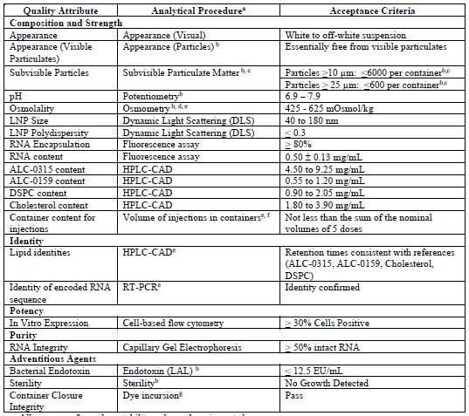
CRITICAL QUALITY ATTRIBUTES OF FINAL DRUG PRODUCT, NOV 2020
L. Maria Gutschi, BScPhm, PharmD

Slide 17
ASSAY Specifications
In house assays by BioNTech
Most needed to be externally validated
No compendial standards when conditional authorization granted
Late migrating species in LNP found only with a more sensitive assay (RP-IP HPLC)
Nucleic acids in mRNA chemically modified by the cationic lipid
Class of impurities missed by historically used analytical techniques
Renders mRNA untranslatable
Clinical impact unknown
L. Maria Gutschi, BScPhm, PharmD

Slide 18
Vial variability
Aggregates
Colour
Discard if particulates or discolouration
Contaminants
Stainless steel particles in Moderna
Cold Chain
L. Maria Gutschi, BScPhm, PharmD

Slide 19
Administration errors
Dosing errors
Reconstitution errors
Administration errors
Other errors
L. Maria Gutschi, BScPhm, PharmD

Slide 20
L. Maria Gutschi, BScPhm, PharmD

Slide 21
Summary
The vaccine product is poor quality and could be considered adulterated
Failure of regulatory authorities for chemistry, manufacturing and control (CMC)
Does not meet criteria for Good Manufacturing Practices (GMP)
Variation could be from batch to batch but also vial to vial
Based on manufacturing standards and lack of basic pharmacological info alone, product should be recalled
Can it be fixed?
Individual response to injection may be even more variable than the variability in the vaccine?
L. Maria Gutschi, BScPhm, PharmD

Slide 22
Sources of variability
Pharmacology of LNPs | “Metabolism” of mRNA | CMC | Antibody Production
Injection site | Mitochondrial health | RNA impurities | Quantity of spike
Distribution | Cell type | dsRNA | Duration of spike
Lymphatic circulation | Fidelity of translation | DNA | Age, sex, weight
Blood circulation | Misfolding/aberrant proteins | Impurities in lipids | Comorbid conditions
Organs | Individual cell kinetics | LNP size range | Lymphocytes
Elimination | Rate of LNP presentation | LNP encapsulation | Immune response
Michaelis-Menton kinetics |  | LNP stability
 |  | Vial variability
 |  | Vial Sterility
 |  | Reproducibility
 |  | Labelling
L. Maria Gutschi, BScPhm, PharmD

Slide 23
Nasani I. Establishing the Pharmacokinetics of Genetic Vaccines is Essential for Maximising their Safety and Efficacy. Clin Pharmacokinet. 2022 Jul;61(7):921-927. doi: 10.1007/s40262-022-01149-8.
L. Maria Gutschi, BScPhm, PharmD

Slide 24
L. Maria Gutschi, BScPhm, PharmD

Slide 25
Independent analysis of quality issues of the BNT162b2 BioNTech/Pfizer Vaccine identified by the European medicines agency
LM Gutschi, BScPhm, PharmD Oct 26, 2022

