Slide 1
COVID-19 Vaccine EMA/Rapporteur CMC Meeting
Confidential
November 26, 2020

Slide 2
Agenda
Intended reply strategy for draft Major Objections (25th November)
Quality items in revised submission plan
Updated drug product specifications
Updated process validation strategy for drug product
Additional filling line and increased batch size for drug product
Any other business

Slide 3
1. Major Objection #1 (GMP status)
GMP status for DS and DP manufacturing sites is currently not acceptably demonstrated:
  a.) A statement on GMP compliance issued by EU supervisory authority of the DS and DP manufacturing and testing sites Wyeth BioPharma Division, Andover, United States and Pfizer Inc, Chesterfield, United States should be available by adoption of the CHMP opinion.
Response for Andover and Chesterfield sites
Ongoing inspection with EMA. Expected to be completed prior to CHMP opinion.
  b.) The MIA for Pfizer Puurs is limited to the formulation and filling only. It should be clarified if authorisation will be extended to all operations listed in 3.2.P.3.1, including LNP manufacturing. Moreover, GMP certificate or a statement of GMP compliance issued by the Supervisory authority of BioNTech Manufacturing GmbH, Mainz, Germany should cover batch certification of the DP.
Response for Pfizer Puurs
Section 3.2.P.3.3 describes all formulation activities starting from Drug Substance Thaw until the addition of cryoprotectant. All those activities are considered as part of formulation and filling processes and are licensed Manufacturing Operations for Biotechnology Products in MIA 277H.
Pfizer Puurs confirms that a license has been obtained for all manufacturing activities as described in 3.2.P.3.1.
Response for BioNTech Mainz
GMP certificate received yesterday and will be provided in MAA

Slide 4
Major Objection #2 (Comparability)
Comparability between clinical and commercial material has not yet been demonstrated, which raises uncertainties about consistency of product quality and hence uncertainties as regards product safety and efficacy of the commercial product. Significant differences between batches manufactured by DS Process 1 and 2 are observed for the CQA mRNA integrity. In addition, the characterisation of BNT162b2 DS is currently not found acceptable in relation to this quality attribute. This is especially important considering that the current DS and DP acceptance criteria allows for up to 50% fragmented species. Therefore, the dossier should be updated with additional characterisation data on mRNA integrity in sections 3.2.S.2.6 (comparability) and 3.2.S.3 of the dossier.
Response:
A comprehensive drug substance comparability study was performed and summarized in roll #2 of the MAA, which includes updated data in 3.2.S.2.6. In addition, we are revising the RNA integrity specification for drug substance to >=60%, drug product release to >=55%, and drug product shelf life to >=50%. The sponsor agrees to update the 3.2.S.3 section with additional characterization data concurrent with the establishment of primary/working reference material.

Slide 5
Major Objection #2 (Comparability)
a.) Truncated and modified RNA species should be regarded as product-related impurities. Even though two methods, namely agarose gel electrophoresis and capillary gel electrophoresis (CGE), have been applied to determine RNA integrity of BNT162b2 DS, no characterisation data on truncated forms is presented. Results obtained on RNA integrity by CGE and agarose gels should be included in the characterisation section (3.2.S.3). The truncated forms should be sufficiently characterised, i.e. they should be described, and it should be discussed if the fragmented species are expected to be similar between batches. In addition, the possibility of translated proteins other than the intended spike protein (S1S2), resulting from truncated and/or modified mRNA species should be addressed and relevant protein characterization data for predominant species should be provided, if available.
Response:
Fragments have been observed in all toxicology, clinical, and representative commercial supply drug substance from Process 1 and Process 2
  Expected product impurity from incomplete in vitro transcription and are confirmed to be RNA
  Most abundant fragment species are 1500-3500 nucleotides in length
  Extensive oligonucleotide mapping data are provided in the revised 3.2.S.2.6 comparability – no significant differences observed
Fragmented species observed by CGE are expected to be comprised of truncated transcripts that include the 5’ region of BNT162b2 but lack the 3’ region and poly(A) tail

Slide 6
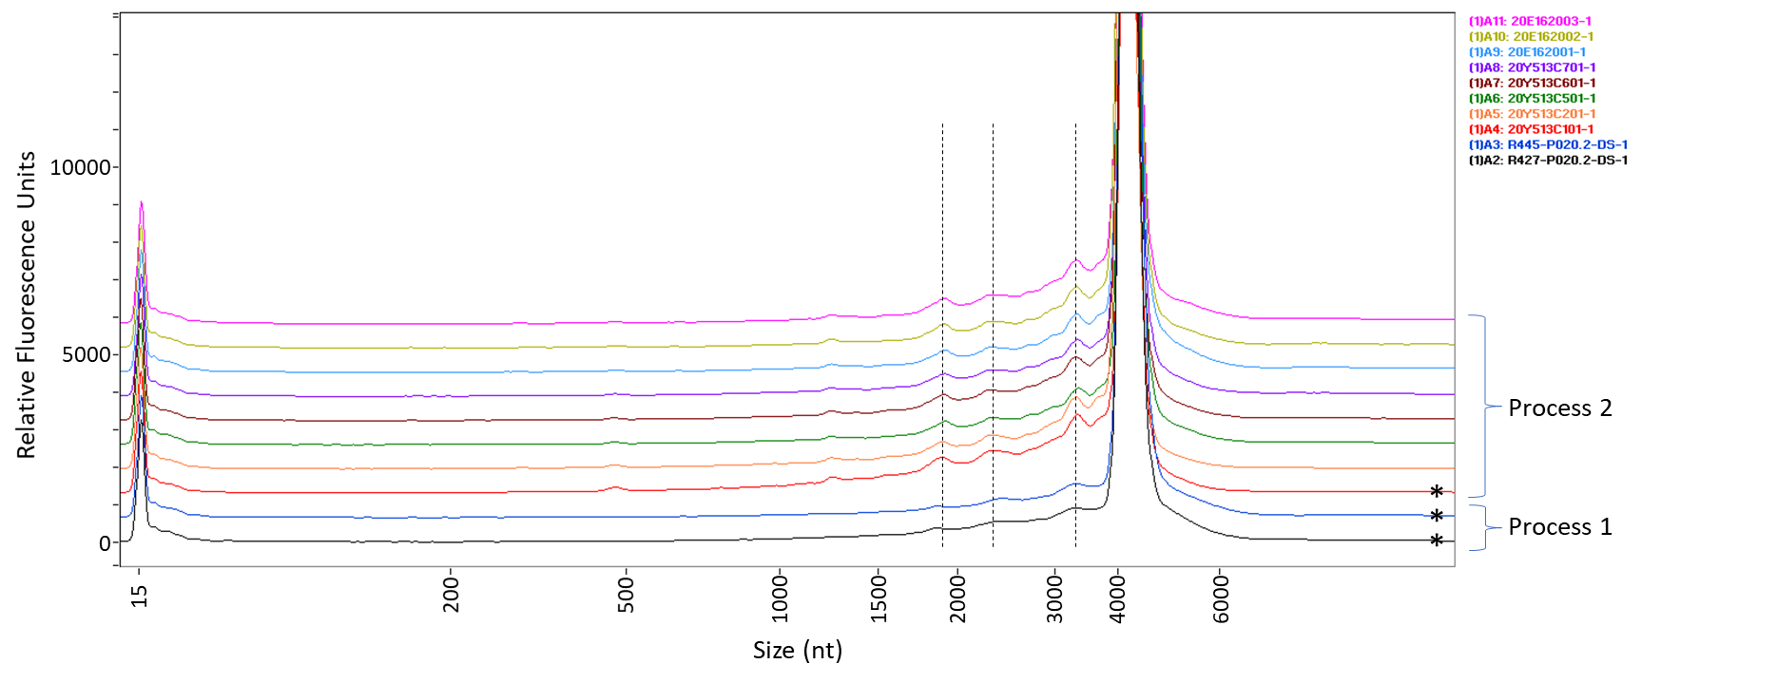
1. Major Objection #2 (Comparability)
b.) Upon changing to DS Process 2, a decrease in RNA integrity was observed (only numerical values provided). Concerning this difference in RNA integrity between Process 1 and Process 2 DS batches the Applicant is requested to provide capillary electropherograms together with an evaluation of any batch differences in peak patterns. The potential safety risks associated with truncated RNA isoforms should be thoroughly discussed with reference to the batches used, clinical experience and possibly literature data. The quantitative and qualitative differences observed between Process 1 and 2 should be discussed with respect to their impact on safety and efficacy.
Response: The electropherograms comparing process 1 and process 2 drug substance batches, inclusive of clinical, emergency supply and PPQ batches, are provided. The major fragments are common between both processes. Truncated transcripts are not expected to impact safety and as they would be degraded or not translated.

Slide 7
1. Major Objection #2 (Comparability)
Comparability (continued)
  c.) For Process 2, the CTP and ATP volumes were adjusted before the manufacture of DS batch PPQ3 to align better with RNA integrity results from Process 1. Additional batch data (from PPQ4 and PPQ5) should be provided to confirm that the optimised Process 2 allows for reaching RNA integrity levels consistent with the Process 1 batches.
Applicant‘s Reply Strategy
PPQ4 and PPQ5 data will be included in the 2nd CMC Roll
3.2.S.2.6 summary table is provided in the back-up for clinical, emergency use, and PPQ batches from Pfizer and BioNTech
BNT162b2 Drug Substance Release and Additional Testing Result Ranges
Method | Clinical (Process 1) | Emergency Supply (Process 2) | ACMF PPQ (Process 2) | BNT-REN PPQ (Process 2)
 | R427-P020.2-DS R438-P020.2-DS R443-P020.2-DS R445-P020.2-DS | 20Y513C101 20Y513C201 | 20Y513C301 20Y513C401 20Y513C501 20Y513C601 20Y513C701 | 20E162001 20E162002 20E162003
RNA Integrity by capillary gel electrophoresis (%) | 77 – 86 | 62 – 69 | 65 – 75 | 70 – 72
5'-Cap by LC‑UV (%) | 56 – 69 | 82 – 84 | 84 – 88 | 89 – 91

Slide 8
1. Major Objection #2 (Comparability)
Comparability (continued)
  d.) After contact with the applicant it was confirmed that DP batches manufactured from early Process 2 batches, with lower RNA integrity, have been recently introduced in clinical trials. However, as the cut-off date for the clinical Interim Analysis (IA) was changed, the IA doesn’t include data from subjects dosed with Process 2 material, and the Company does not expect to have Process 2 included in the Final Analysis dataset. Therefore, the proposed acceptance criteria of ≥50% intact RNA for RNA integrity is considered too wide compared to clinical batch data, 69-81%. The proposed release and shelf-life acceptance criteria for the DP should therefore be tightened based on the clinical data included in the dossier or clinically qualified by other means.
Applicant‘s Reply Strategy
Proposed specifications are now DS release/shelf life >=60%, DP release >=55%, DP shelf life >=50%
Capped-intact is comparable for Process 2 DS, therefore even the slightly lower integrity not expected to affect efficacy, comparable IVE results are supportive of this as well. Additional adjustments to improve DS integrity have been implemented.
Clinical drug product batch range from 62-86% integrity; mean - 3SD has lower limit of 47%
Specifications will continue to be assessed following drug product PPQ

Slide 9
1. Major Objection #2 (Comparability)
Comparability (continued)
  e.) Release data provided for some of the DP batches indicates a possible decrease in mRNA integrity during the manufacturing of DP. The applicant should therefore discuss possible root causes, and present comparative results for DS and DP, on RNA integrity. A consequential need for a more stringent DS specification should be considered. Sections S.4.1 and P.5.1 in the dossier should be aligned and updated accordingly.
Response: The sponsor acknowledges a consistent drop in RNA integrity between final DS release and final DP release. Comparative results for DS and DP are provided. We have implemented a more stringent DS specification (>= 60% for release/shelf life)
DP Lot | Ingoing DS Batch | RNA Integrity (%) |  | Integrity Difference (%) (DP-DS)
 |  | Drug Product | Drug Substance
EE8492 | 20Y513C101 | 55 | 62 | -7
EE8493 | 20Y513C101 | 55 | 62 | -7
EJ0553 | 20Y513C501 | 68 | 75 | -7
EJ1685 | 20E162001 (1071539) | 66 | 72 | -6
EJ1686 | 20E162001 (1071539) | 69 | 72 | -3
EK1768 | 20Y513C401 | 60 | 65 | -5

Slide 10
1. Major Objection #3 (Process validation)
Drug product batches manufactured at the commercial facility (whole manufacturing process at the commercial site Pfizer, Puurs, at commercial scale, drug substance from process 2) were not presented. Process validation (PPQ) for commercial scale batches are already initiated and validation data should be provided. Batch results for at least 2 commercial scale batches representative of the commercial process should be presented. Comparability of commercial batches with clinical batches should be demonstrated and the data should be provided. The claimed shelf-life and storage condition are not yet acceptable since no stability data is available for batches from the commercial manufacturing site and scale and shelf-life is based on very small scale (development) batches (less than 1% of the commercial scale), not representative of the commercial batches (manufacturing site, scale, process for the drug substance). Additional stability data (6 months at long-term storage condition) should be presented.
Response:
Batch results of at least 2 GMP batches will be submitted around the 2nd CMC Roll (precise date pending)
Phased approach for process validation (see Agenda Topic 4)
  Phase I, initial validation (5 PPQ lots at 5 sites including Pfizer Puurs): scheduled this week
  Phase II, full validation (7 PPQ lots in total at Pfizer Puurs): to commence in Week 51
Stability and shelf-life:
  Details presented on next slide

Slide 11
1. Major Objection #3 (Process validation) continued
Stability and shelf-life:
  Stability studies have been initiated/are in progress for six additional EUA lots of DP and include storage at the intended storage condition of -90 to -60℃. These studies are representative of the commercial process/scale and information on stability protocols and data available are being provided in MAA roll #2. Additionally, MAA Roll #2 contains the draft, planned PPQ stability protocols, as well as new data available for BNT clinical lots.
  A summary of the stability data available in MAA roll #2 is summarized below:
    Updated stability data for 6 months at intended storage on clinical lot BCV40420-A and non-clinical lot CoVVAC/270320 support the current claimed shelf life
    Up to 2 weeks stability data on EUA lot EE8492
    Stability protocols and release data, where available, for EUA lots EK1768, EJ1686, EJ1685, EJ0553 and EE8493 (information on EE8493 was provided in MAA roll #1)
    Inclusion of protocols and up to 3 months stability data for additional BNT clinical lots, including lots EE3813 (alias BCV40820-P) and ED3938 (alias BCV40720-P) which were manufactured on a scale more representative of the commercial process

Slide 12
2. Quality items in revised submission plan (25th November)
26th November
Company’s Responses to FDA’s questions for the US EUA submitted.
30th November
Submission of relevant quality data for EU supply chain as ‘pre-read’ for quality assessors:
  ‘Global EUA’ dossier contains to a remarkable extent CMC data, which are not relevant for EU supply chain
  Change in plans: Submission of a selection of M3 sections which contain either most important changes/updates or comprehensive update. A copy of sections will be taken from the ongoing process of data verification. As data verification process is not fully completed the sections are formally considered as draft although changes are very unlikely.
  Examples: S.2 / S.4 / S.5 for New Drug Substance Site BioNTech/Rentschler, P.2 Drug Product,
  P.2.6 Compatibility, P.3.2 Batch Formula, P.3.3 Manufacturing Process, P.5.1 Drug Production Specification and Stability updates for DS and DP
4th December
Submission of 2nd CMC roll package formally as part of VSI responses via eCTD:
Module 3 and Module 2 abbreviated QoS.
Abbreviated QoS includes a summary of pending information and confirmation that Quality is acceptable
The Quality expert signature was already submitted in sequence 0002.

Slide 13
3. Updated specifications for drug product
Quality Attribute | Analytical Procedure | Acceptance Criteria (1st CMC Roll) | Acceptance Criteria (2nd CMC Roll)
Appearance (Visible Particulates) | Appearance (Particles) | Essentially free from visible particulates | May contain white to off-white opaque, amorphous particles
RNA Integrity | Capillary Gel Electrophoresis | ≥ 50% intact RNA | ≥ 55% intact RNA (release) ≥ 50% intact RNA (stability)
Visible particles contain lipids and are thus intrinsic to the product
RNA integrity:
  ≥ 55% at release with an allowance of 5% decrease across stability
  Late migrating species (LMS) shown to be intact RNA
Data and discussion presented in briefing materials
  Draft Section 3.2.P.2.2 Drug Product
  Reply to US EUA Questions

Slide 14
4. Updated validation strategy for drug product
Phased approach to ensure having preliminary PV data available from individual supply nodes
as soon as possible for conditional EU MAA, US EUA, and other applications
Phase I:
Manufacturing of one batch from each global supply node
Five PPQ lots scheduled this week at five DP manufacturing sites:
  Node #1: EU supply (FC2 filling line, Pfizer Manufacturing Belgium NV, Puurs)
  Nodes #4 & #5: Comparable to EU supply (Pfizer Kalamazoo, USA, filling lines 8 and 18)
  Node #2 & #3: Supportive data (Pulymun / Pfizer Puurs and Dermapharm / Pfizer Puurs)
Comparability assessment scheduled for all PPQ lots
Phase II:
Global validation approach which includes EU supply
Pfizer Manufacturing Belgium, Puurs:
  Scheduled for Week 51/2020 – Week 02/2021
  Additional six PPQ lots to give a total of seven PPQ lots for Pfizer Puurs
  Matrix approach to address different DS supply sites (Andover vs BioNTech/Rentschler),
  different fill lines (FC2 vs VC2) and different scales (139 L vs 278 L)
Comparability assessment scheduled for all PPQ lots

Slide 15
5. Additional filling line and increased batch size for drug product
Changes in 2nd CMC Roll for assuring sufficient EU supplies
prior to submission of variations to add further DP manufacturing sites
Additional filling line (Pfizer Manufacturing Belgium NV, Puurs)
An additional filling line (VC2) is introduced for BNT162b2 drug product and descripted is described in the respective sections in the MAA.
Validation of the VC2 filling line is planned in Phase II of process validation
Batch size increase for DP process (Pfizer Manufacturing Belgium NV, Puurs)
Two TFF unit operations in parallel during the DP process (Step 5 in Section 3.2.P.3.3) to increase batch size
Batch size in Section 3.2.P.3.2 changed from 139 L to 139 L - 278 L range
Change supported by:
  one completed engineering lot
  a first GMP lot scheduled to be completed this week.
Validation of the 139 L - 278 L range is planned in Phase II of process validation

Slide 16
Backup

Slide 17
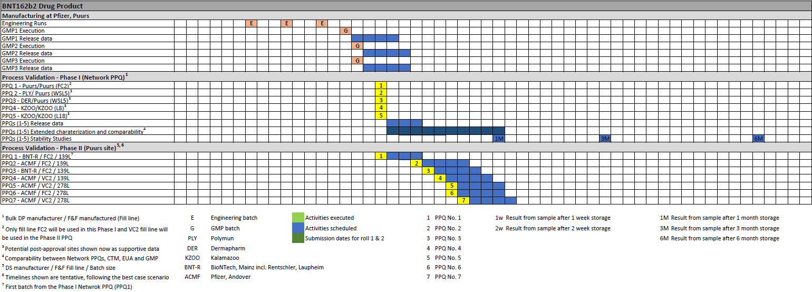
Revised manufacturing plan – DP PPQ lots

Slide 18
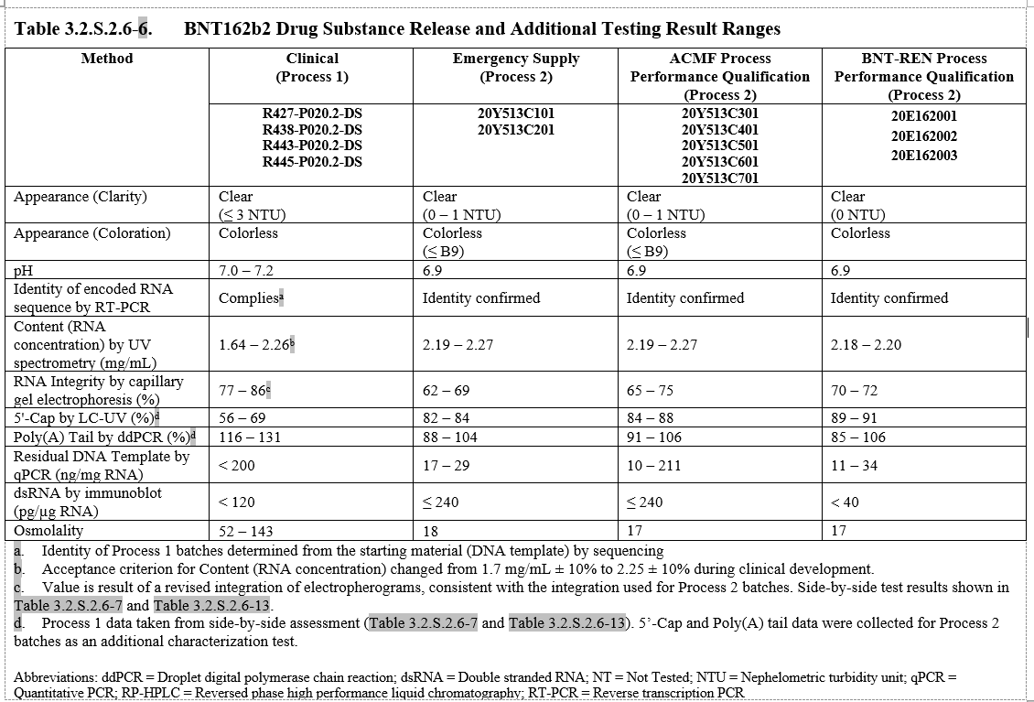
MAA Draft – Roll 2, 3.2.S.2.6
pending review

Slide 19
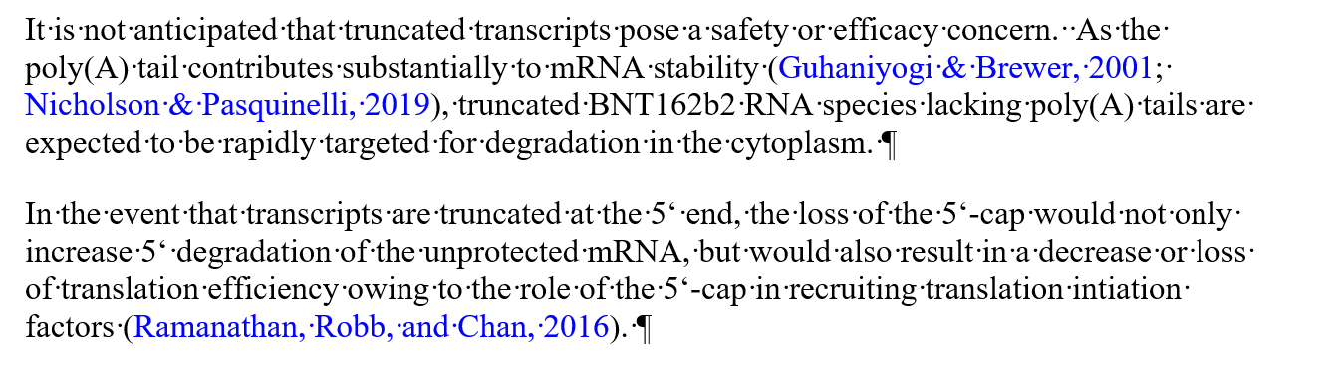
Truncated transcripts

Slide 20
Statistical analysis of data sets for integrity specification
Statistical analysis of data sets for integrity specification:
Data set:
Bolded lots used in clinic to date.
Statistical analysis:
DP Lot | %Integrity
BCV40420-A | 75
BCV40620-A | 85
BCV40620-B | 86
BCV40620-C | 83
BCV40620-D | 77
BCV40620-E | 85
BCV40720-A | 71
BCV40720-B | 72
BCV40720-C | 69
BCV40720-P (ED3938) | 62
BCV40820-P (EE8318) | 63
EE8492 | 55
EE8493 | 55
EJ0553 | 68
EJ1685 | 66
EJ1686 | 69
EK1768 | 60
Lots included | Mean | Std Dev | Mean – 3SD
All | 70.6 | 10.1 | 40.3
Clinical only (all bolded) | 72.5 | 10.4 | 41.3
Clinical without EE8493 | 74.3 | 9.0 | 47.3

Slide 21
DS release and additional testing ranges
BNT162b2 Drug Substance Release and Additional Testing Result Ranges
Method | Clinical (Process 1) | Emergency Supply (Process 2) | ACMF Process Performance Qualification (Process 2) | BNT-REN Process Performance Qualification (Process 2)
 | R427-P020.2-DS R438-P020.2-DS R443-P020.2-DS R445-P020.2-DS | 20Y513C101 20Y513C201 | 20Y513C301 20Y513C401 20Y513C501 20Y513C601 20Y513C701 | 20E162001 20E162002 20E162003
RNA Integrity by capillary gel electrophoresis (%) | 77 – 86 | 62 – 69 | 65 – 75 | 70 – 72
5'-Cap by LC‑UV (%)^{d} | 56 – 69 | 82 – 84 | 84 – 88 | 89 – 91

